Slide 1

How to Start an IT Company
Benjamin Brewster
Except where noted, content, art, and pictures are by the author

Slide 2
Why You Need to Care
Because someday you’ll have to:
Considering using your skills on behalf of your own entrepreneurial spirit
Create a de facto IT department inside a company that doesn't traditionally have one (this is horrifyingly more common than you might think)
This is kind of a business lecture. Sorry about that.

Slide 3
Types of Companies
You could start lots of different kinds of IT companies; here are a few:
MSP, focused on businesses, homes, or both
Computer/hardware repair shop
Forensic/data recovery shop
IT/IS/Operations roles typically done as part of a company or as a mercenary/outside/external/outsourced contractor:
DevOps
Software developer
Art

Slide 4
High Level Needs
Regardless of company type, or new internal IT department, you need to have these done before you can begin business
Procedures
Hardware
Personnel, with actual time
Cash money, on the barrelhead, to actually pay people, no foolin'
Unless you can convince people with your passion, of the potential payoff, of the experience, or you don't mind swindling
Workspace

Slide 5
Procedures
Procedures will be needed for:
Customer service requests
Contracting services with customers
Providing services
Record keeping
Financial accounting
Asset monitoring
Reporting
Marketing
We'll go through each one in detail

Slide 6
Customer Service Requests
How will customers contact you to submit issues?
Phone and email are traditional, but you can also hook the email into ticket systems that track issues in a database for you
Help desk software that tracks all tickets is critical! Commonly used products are: Zendesk, Spiceworks, ConnectWise, etc.

Slide 7
Contracting Services with Customers
There are a billion ways to contract with clients, but these are typical:
Long-term support contracts (Service Level Agreements) that specify Service Level Objectives that you need to reach and sustain
Month-to-month support contracts that take care of any issue that arises
One-off "walk-in" jobs that use a liability waiver and work agreement

Slide 8
Providing Services
You need bullet-proof procedures for how you're going to handle jobs!
How you accept the work, put it on the shelves, get it back off again, open the computer, remove the virus, remotely connect to machines and service them, dismantle hardware, build custom machines for resale, store customer data during recovery, etc.
You'll eventually need a procedure for each of these

Slide 9
Record Keeping
The work you do needs to all be written down in the ticketing system to achieve many objectives:
Closing the loop - the next engineer needs to know what has been done so that work can be continued from that point
Recording work done so that billing can be done
Capturing the solution so that it can be duplicated again in the future
Proving that specific work, configurations, or time was spent
Keeping configuration items: records of usernames, passwords, IP addresses, software licenses, notes about program and device usage, location of device, how to access device, etc.
My company fired people for failing to ticket properly. It is a BIG DEAL.

Slide 10
Financial Accounting
Someone, possibly you, is going to need to keep the books
You create invoices from the ticketing system, send them out, then track incoming money
Budgets are created to know how much you can spend; future forecasting allows you to hire personnel, buy equipment, and expand

Slide 11
Asset Monitoring
If you're an MSP, you need to monitor all of your customer devices and be alerted to serious conditions; someone is going to be on-call at any given second: do you have staff to support that?
For any shop, you need to keep track of your own internal hardware so that you have operational continuity
Typical products for managing and monitoring devices are Nagios, Continuum (and other MSP software), Kaseya, Spiceworks

Slide 12
Reporting
With sufficient data, you can create reports for your own purposes:
Do we have enough profit monthly to hire another engineer?
Can we upgrade the services we provide with the profits we are getting?
Do we need to increase our prices to reach, extend, or maintain profitability?
Are we taking too long to solve customer issue X?
How fast are we answering new service requests in the first place and do our customers consider this a strength or a weakness? Can we do anything about it; how does it affect us if do make a change?
Is our Yellow Pages campaign succeeding? (hint: no)

Slide 13
Marketing
Marketing is done as a standalone business and as a internal department:
Businesses need brand awareness above pretty much everything else
Internal shops need to advertise their capabilities and publish success stories so that staff know to trust and use them, even if it's required
For a standalone business, marketing should probably be your second highest cost, after HR
(Remember that HR is salaries, insurance, training, all other perks)

Slide 14
Hardware
You don't want any
But you have to have some:
Computers to do accounting & customer intake
Computers and devices that are used as test beds and tools: forensic analysis, hardware testing, data recovery, etc.
Engineer computers for record keeping, remote connection to clients, email, personal projects that help grow employee skills, and "network bandwidth testing"
"Network bandwidth testing" is critical: we allowed it during breaks, lunch, and outside of business hours
In the beginning days of a new business, you can do most of this with just one laptop, but it'd be better if you can get a few boxen

Slide 15
Hardware
Your network closet will likely have routers that allow multiple public internet connections for testing routers and advanced network configurations
Running your own server for file storage is great, but you have to protect it just like anyone else's
Don't run email or data backup servers as a service internally anymore: it's done online better, cheaper, safer, and more reliably

Slide 16
Personnel / HR
Staffing issues are always the most important issues; no work can be done without people (even automation has to be monitored)
People want lots of things (respect, money, insurance, career and knowledge growth, etc.)
You can't start a business without sufficient time, either as a standalone, or as an internal department
Beware "interesting" opportunities that ask you to do IT "half-time"

Slide 17
Cash Money
There's a saying in IT: you can't save money when an IT problem arises
It's going to cost you now, or later, but it will cost, leading to an uncomfortable series of trade-offs
Choose two: Fast, cheap, high-quality
People don't work for free unless their passionate about the project
And they're lying to you when they say they'll work for free: it won't last
You can start IT companies at a small scale fairly cheaply (more later)!

Slide 18
Workspace
Your size and customer servicing needs dictate your office space
I started my business in one half of my kid's bedroom, moved it out of the apartment to an 80 sq ft room rented from a client of mine, to a 160 sq ft room with that client, then to 800 sq ft commercial space, finally to 1200 sq ft commercial space
Space is used to store things - you should try it
Commercial space is insanely expensive: it is a very large fixed cost

Slide 19
Class Conclusion: An MSP & Walk-In Shop in One Slide
Procedures binder
Spiceworks (ticketing, record keeping, invoice generation, device monitoring)
LogMeIn (remote connection)
Nagios for client internal monitoring, for bigger sites
QuickBooks (financial accounting)
Service Level Agreements/contracts for all types of customers
Computer for each engineer
Shelves to store customer equipment being worked on
Marketing plan

Slide 20
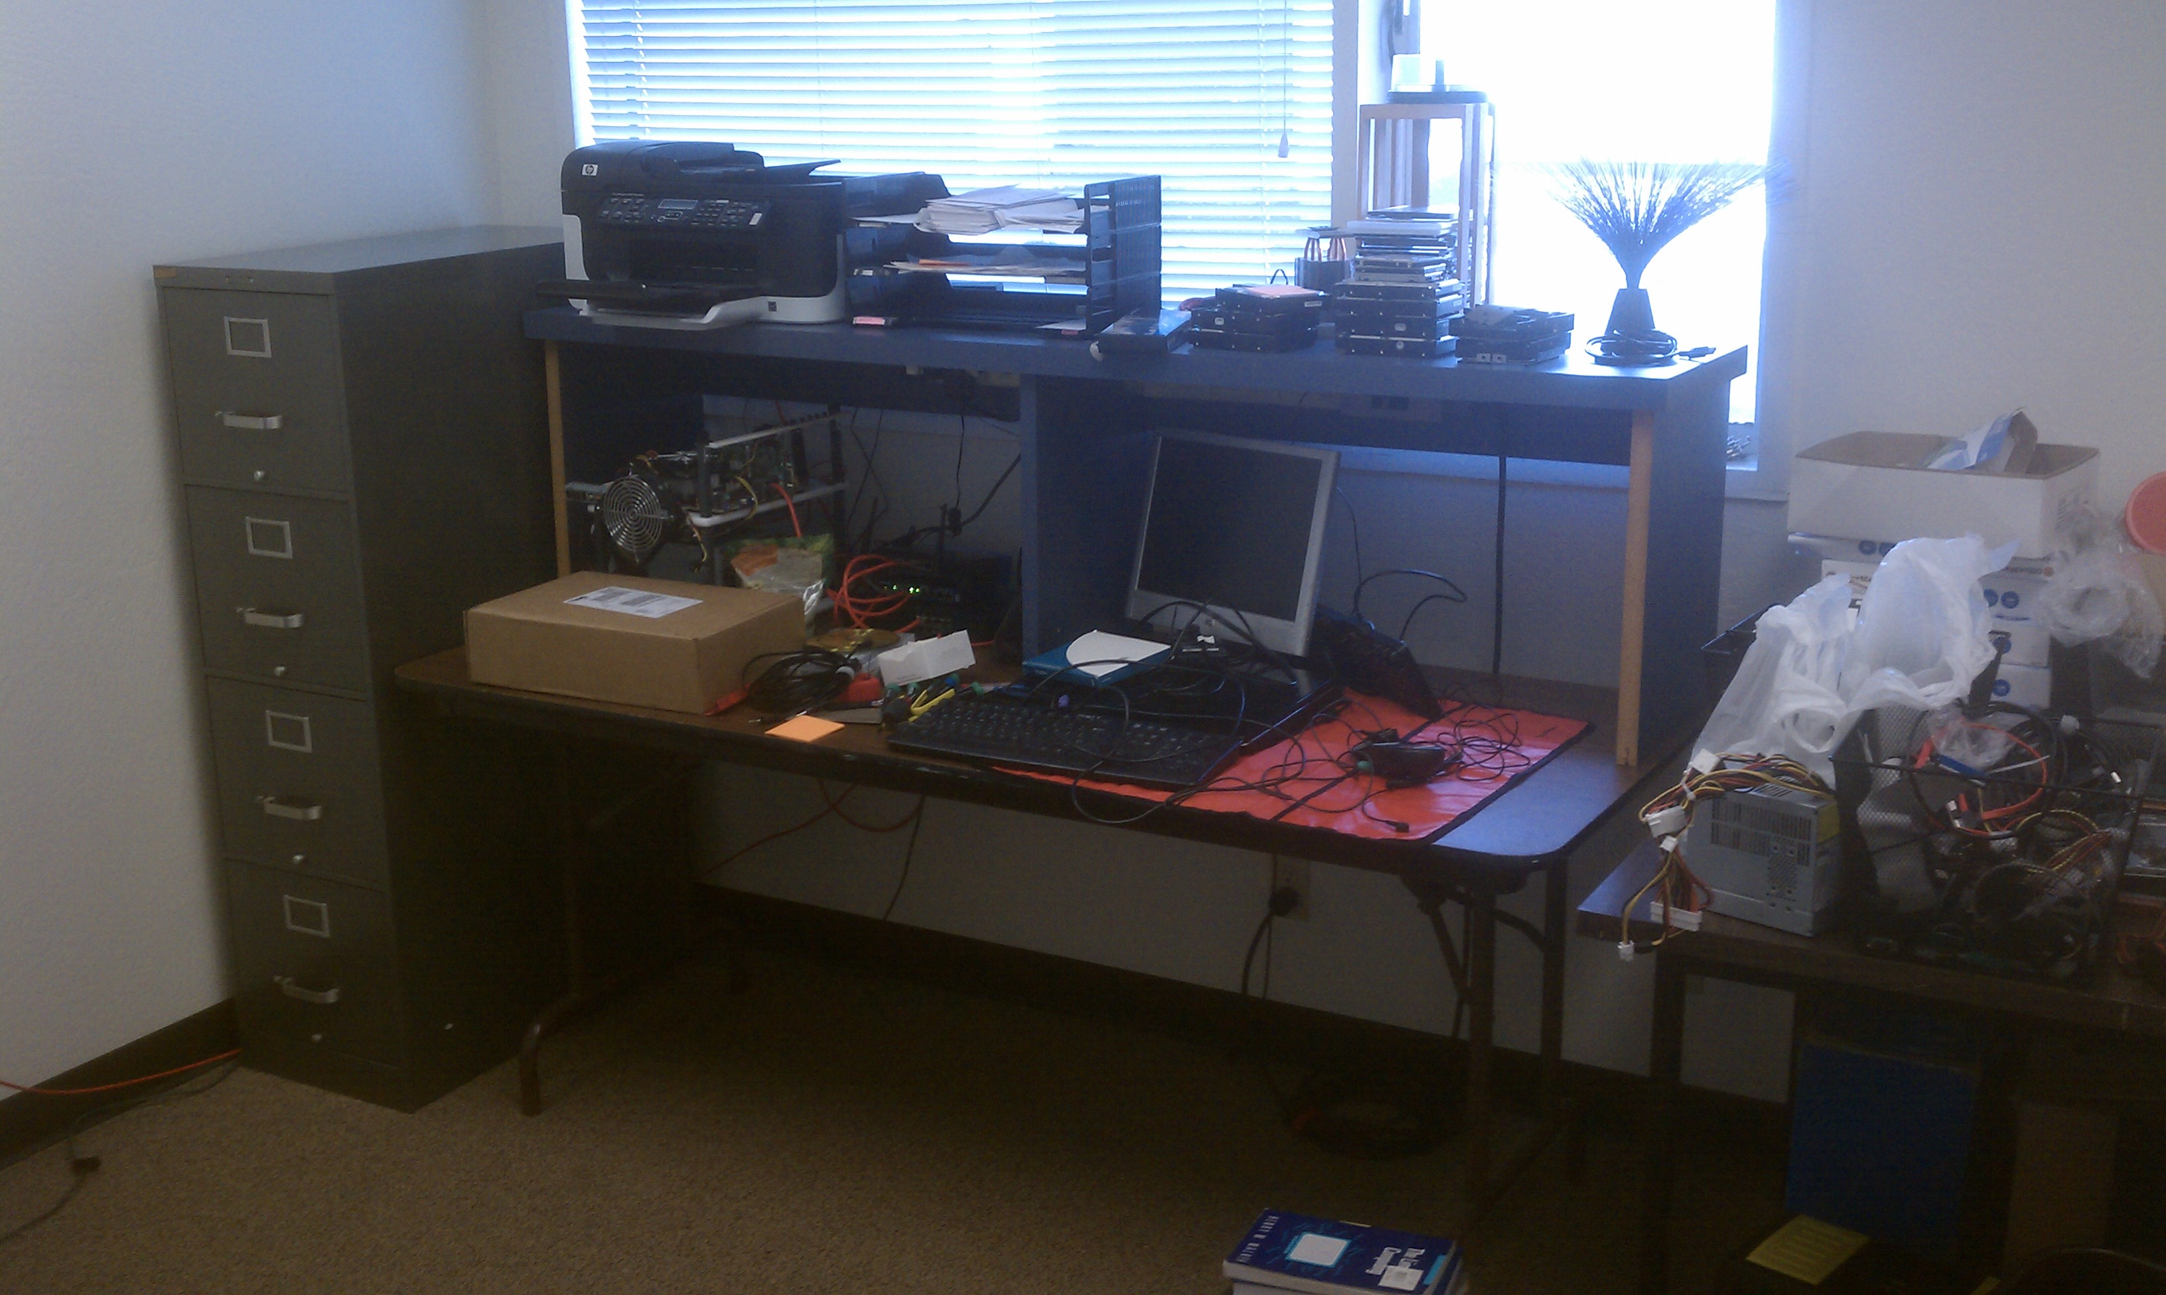
Picture Dump!

Slide 21
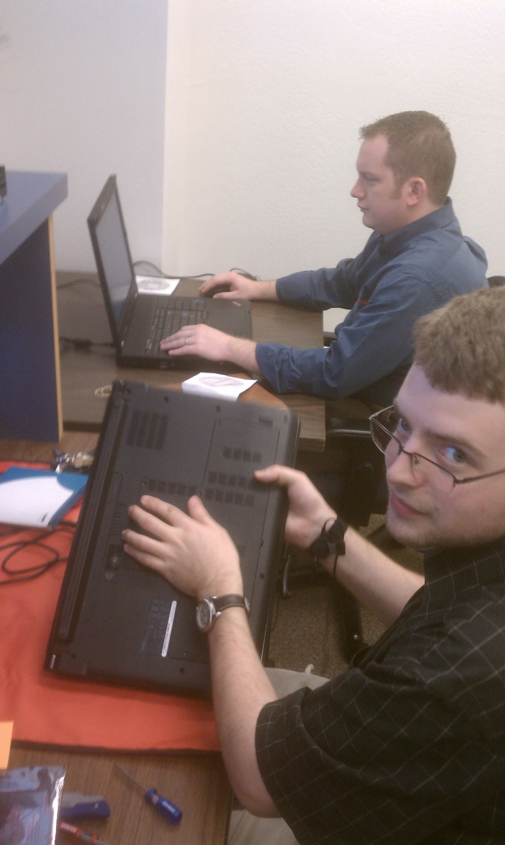

Slide 22
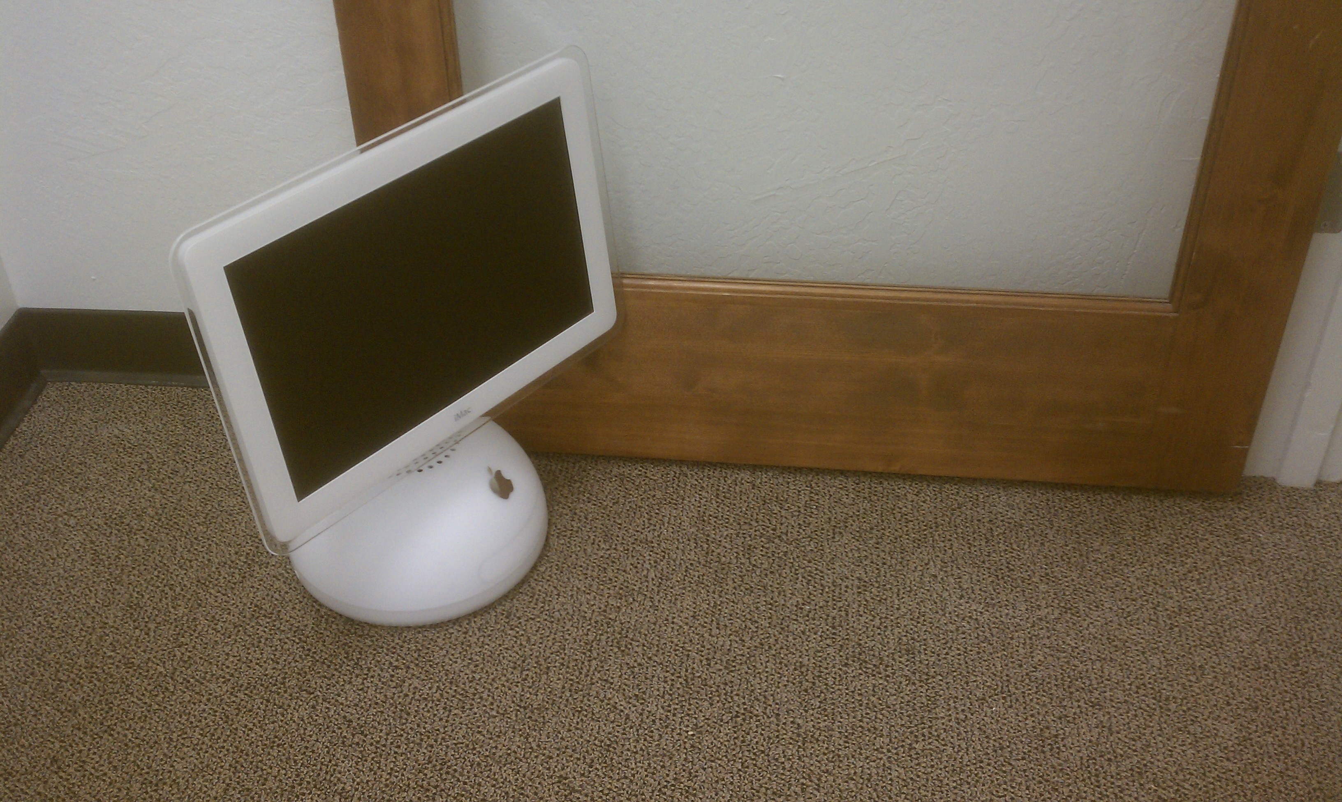

Slide 23
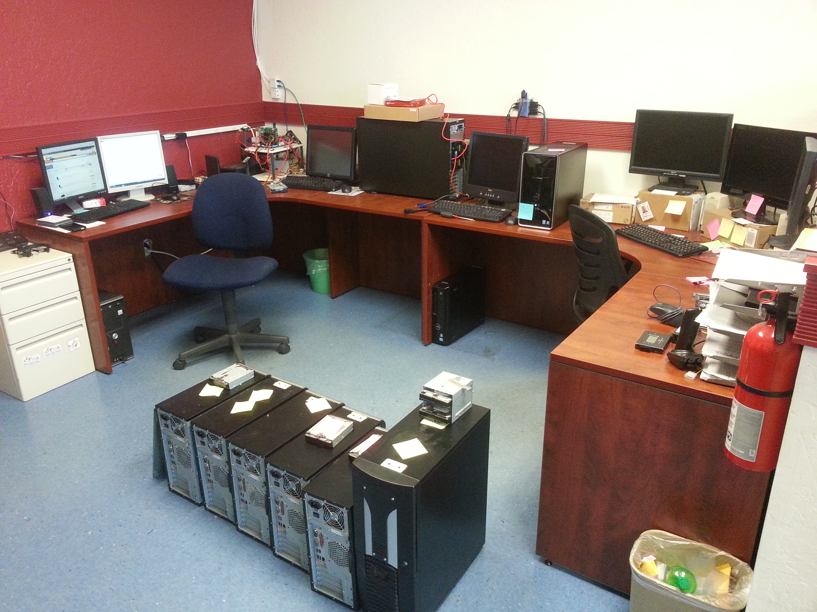

Slide 24
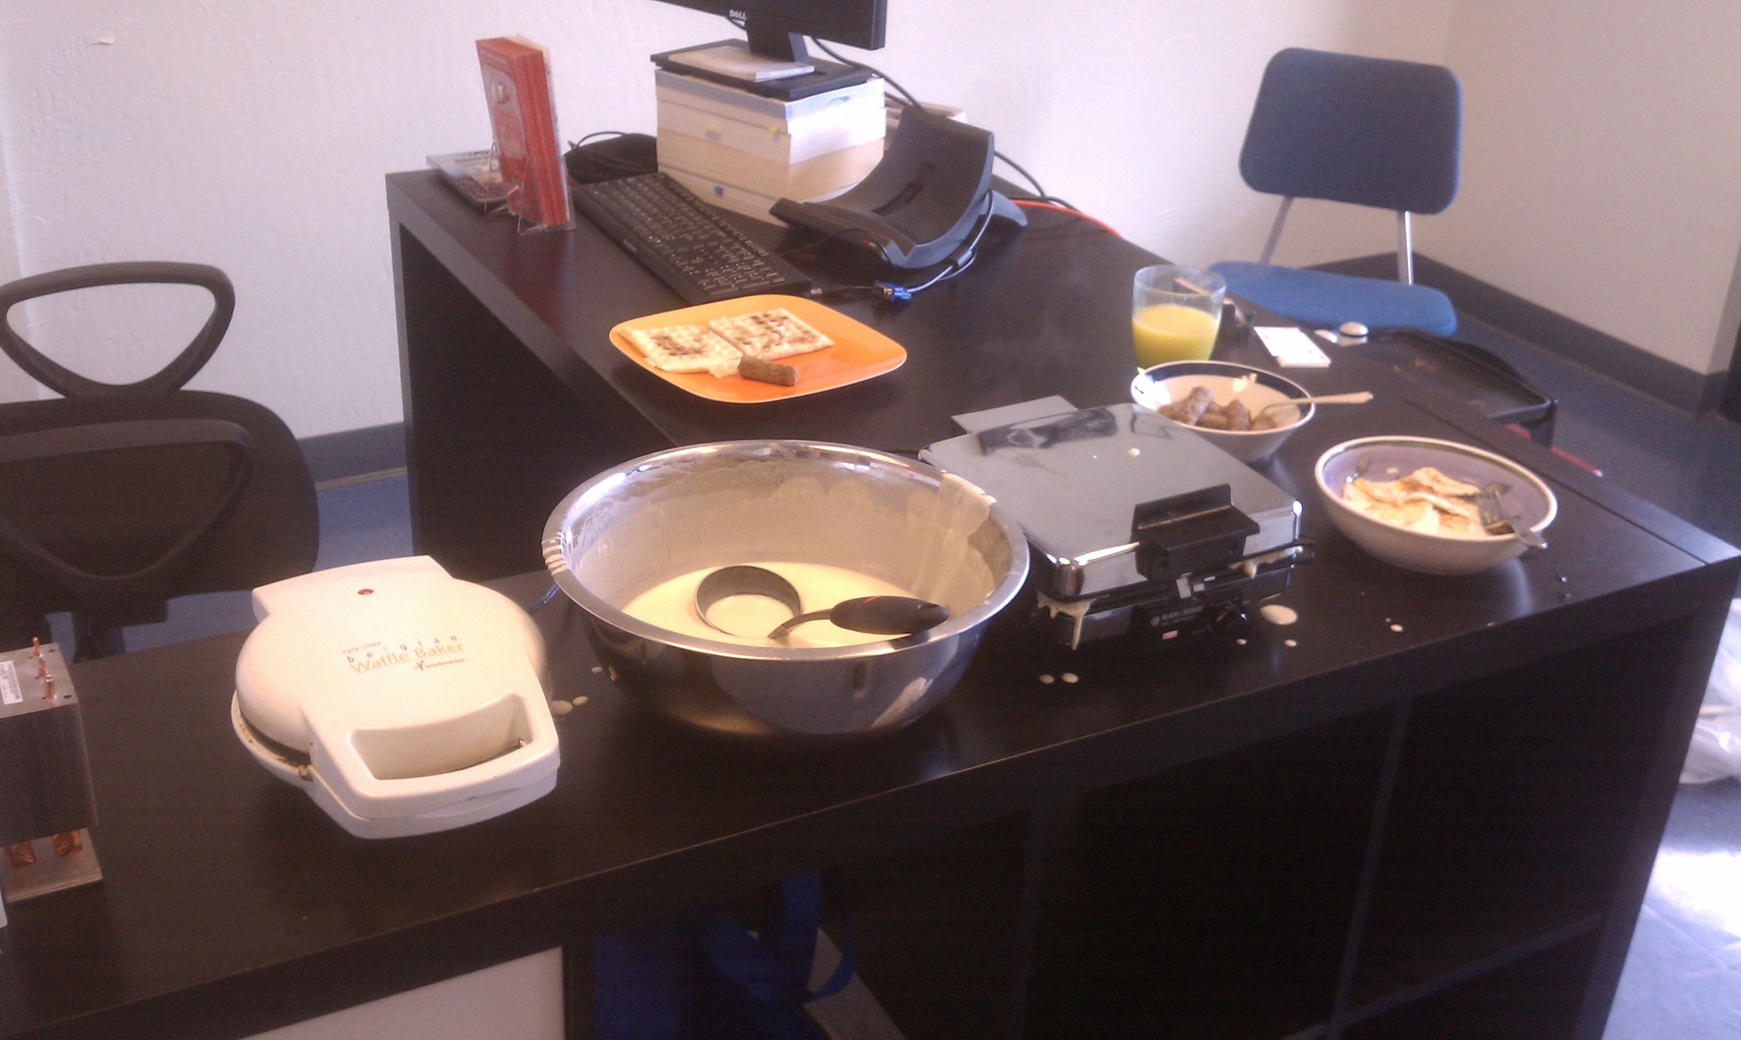
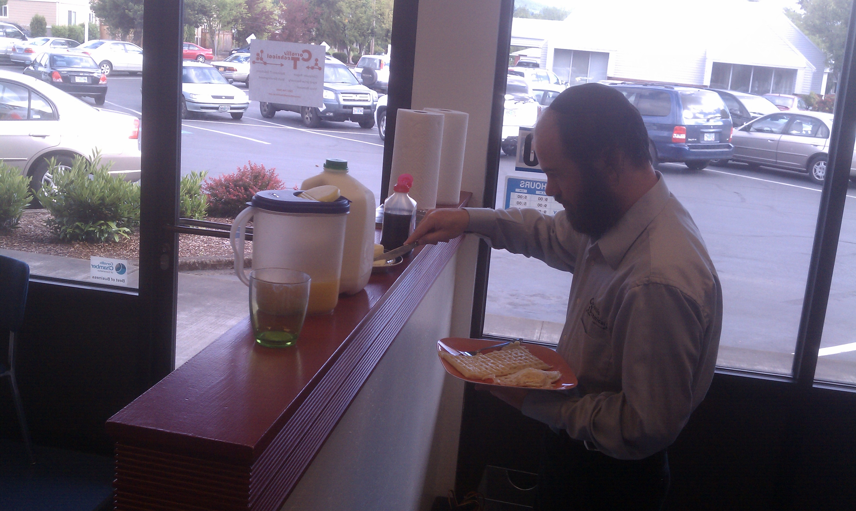
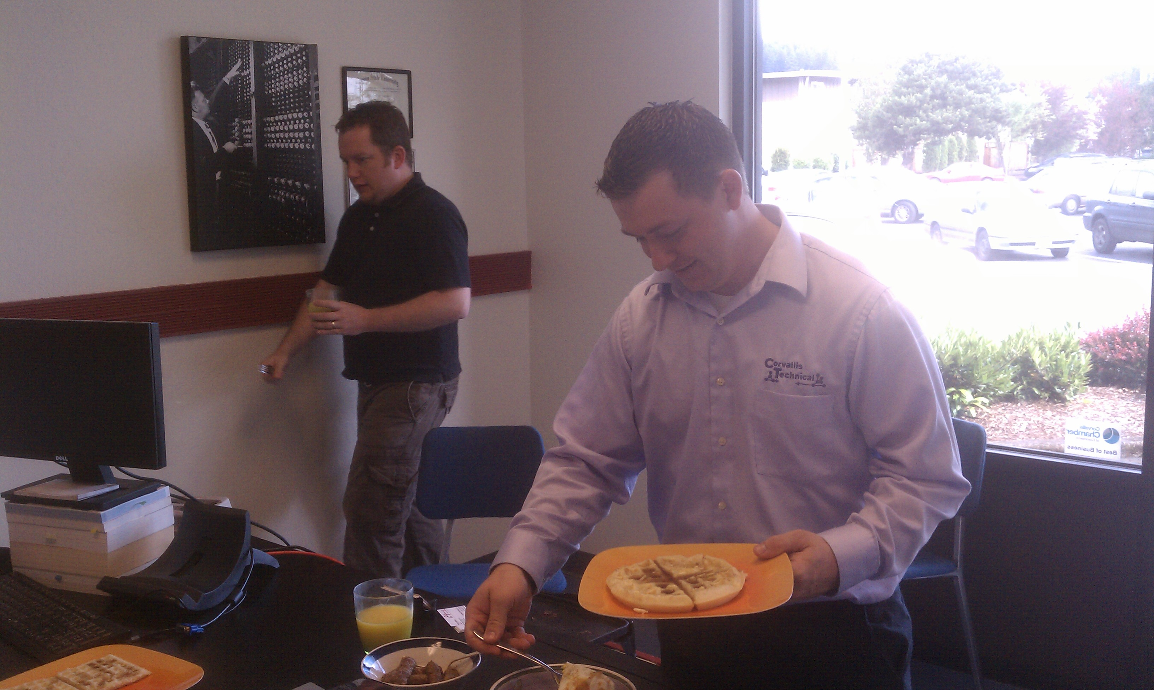

Slide 25
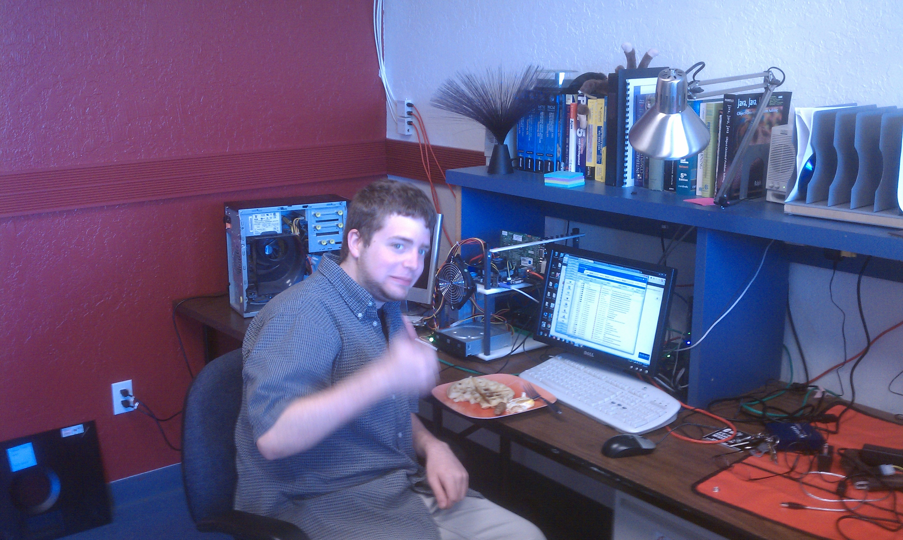

Slide 26
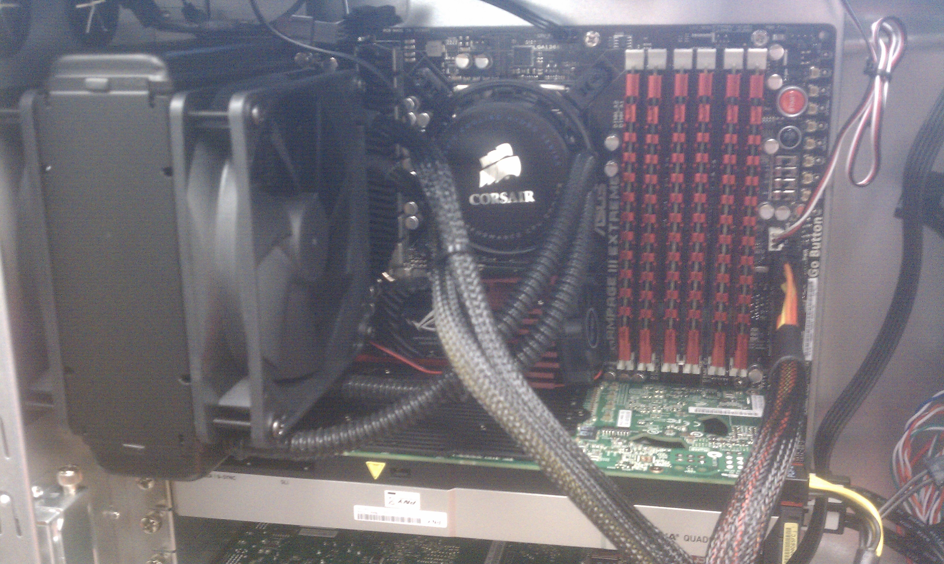

Slide 27
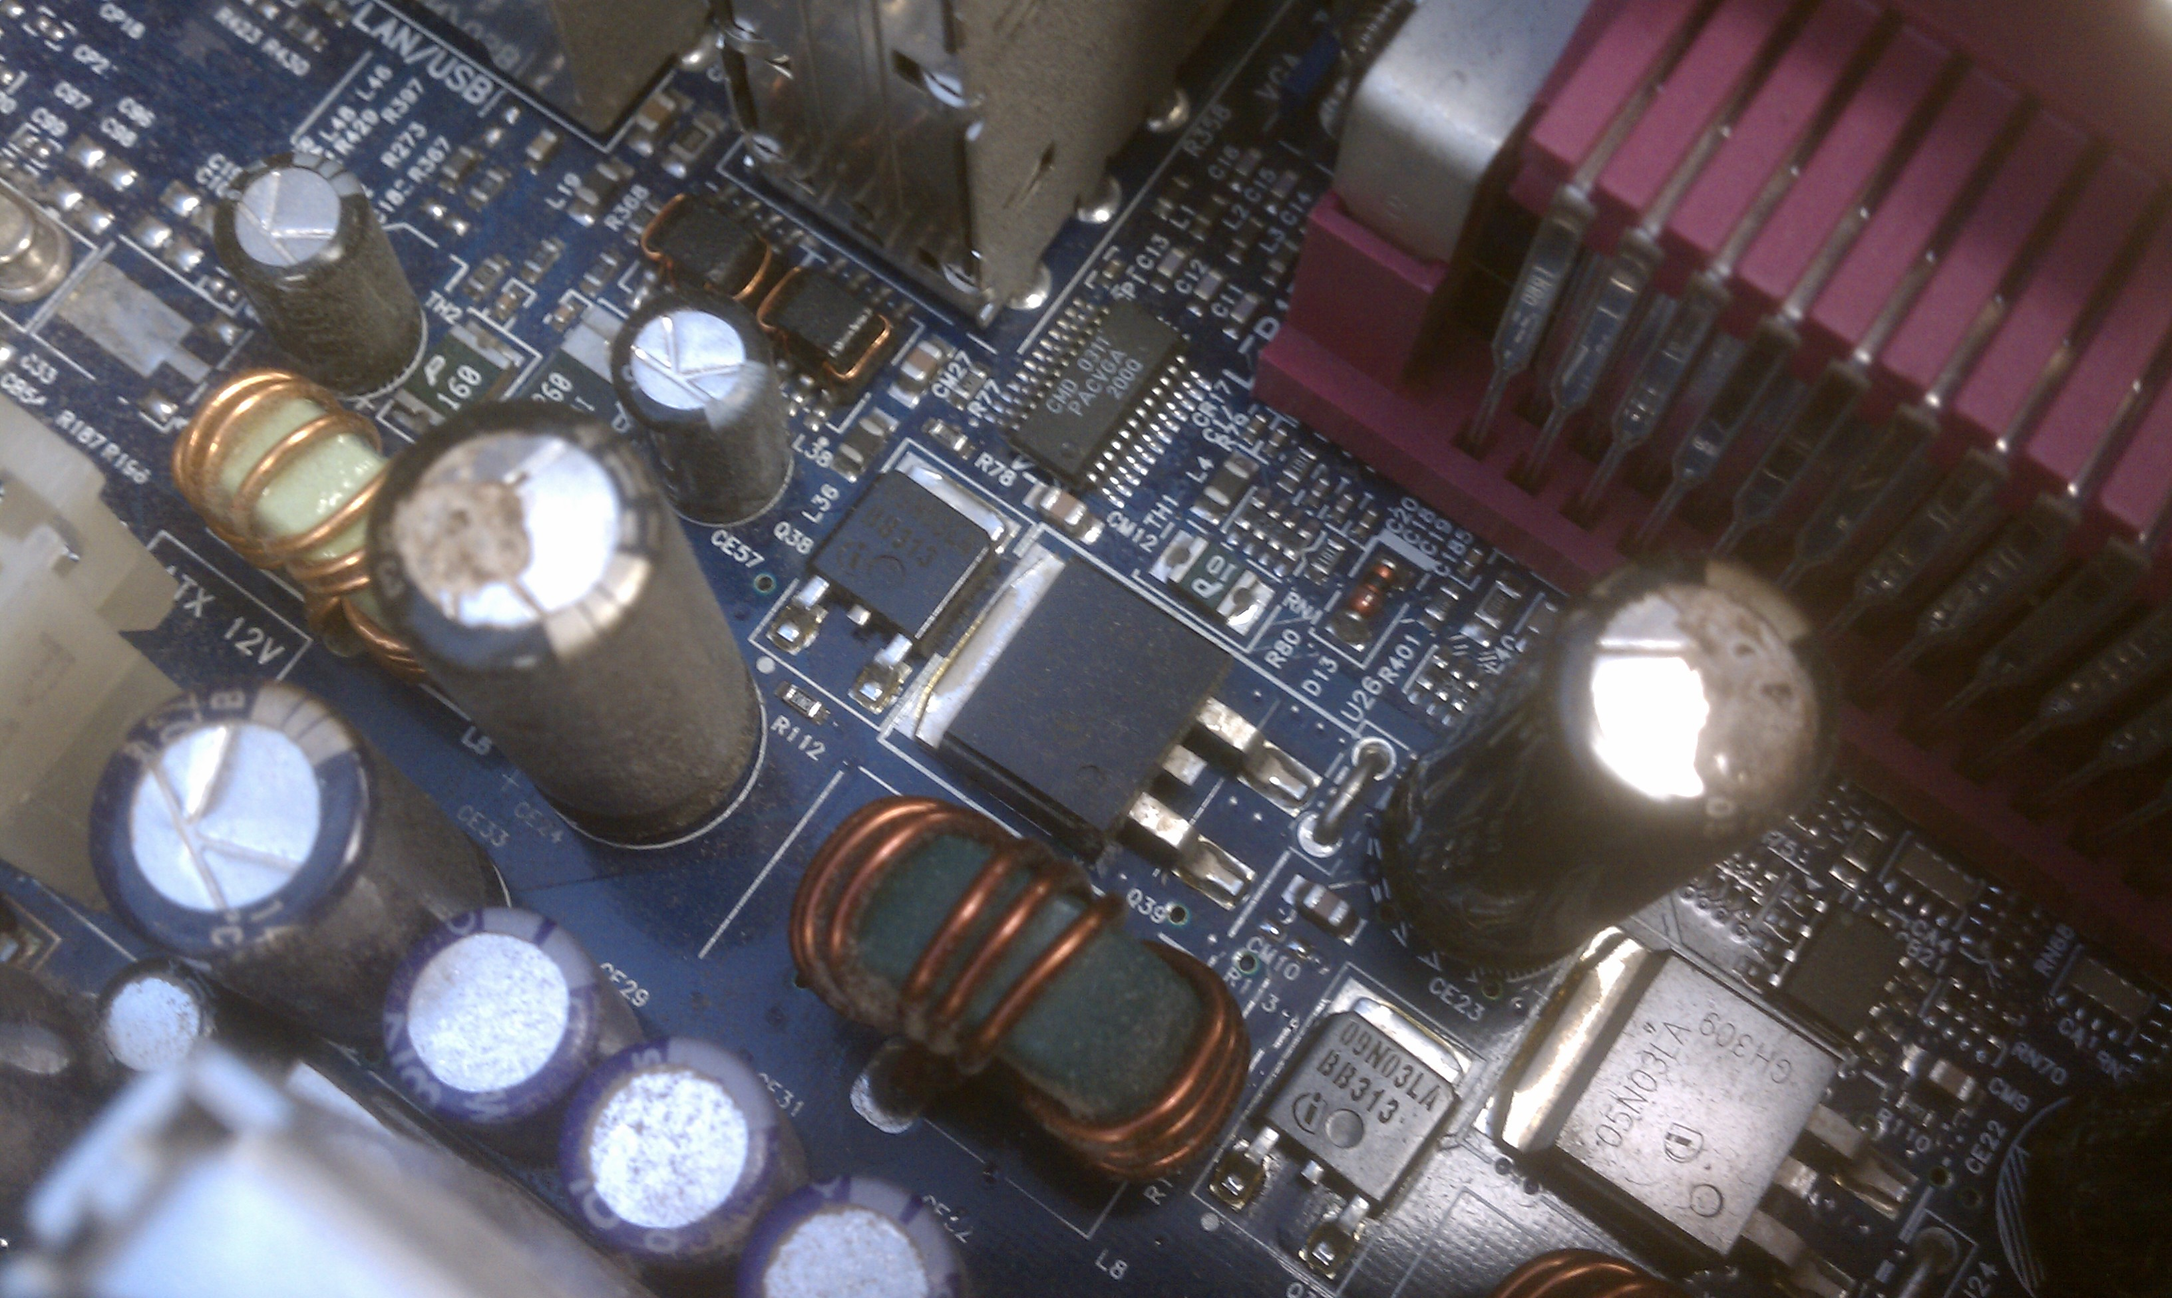

Slide 28
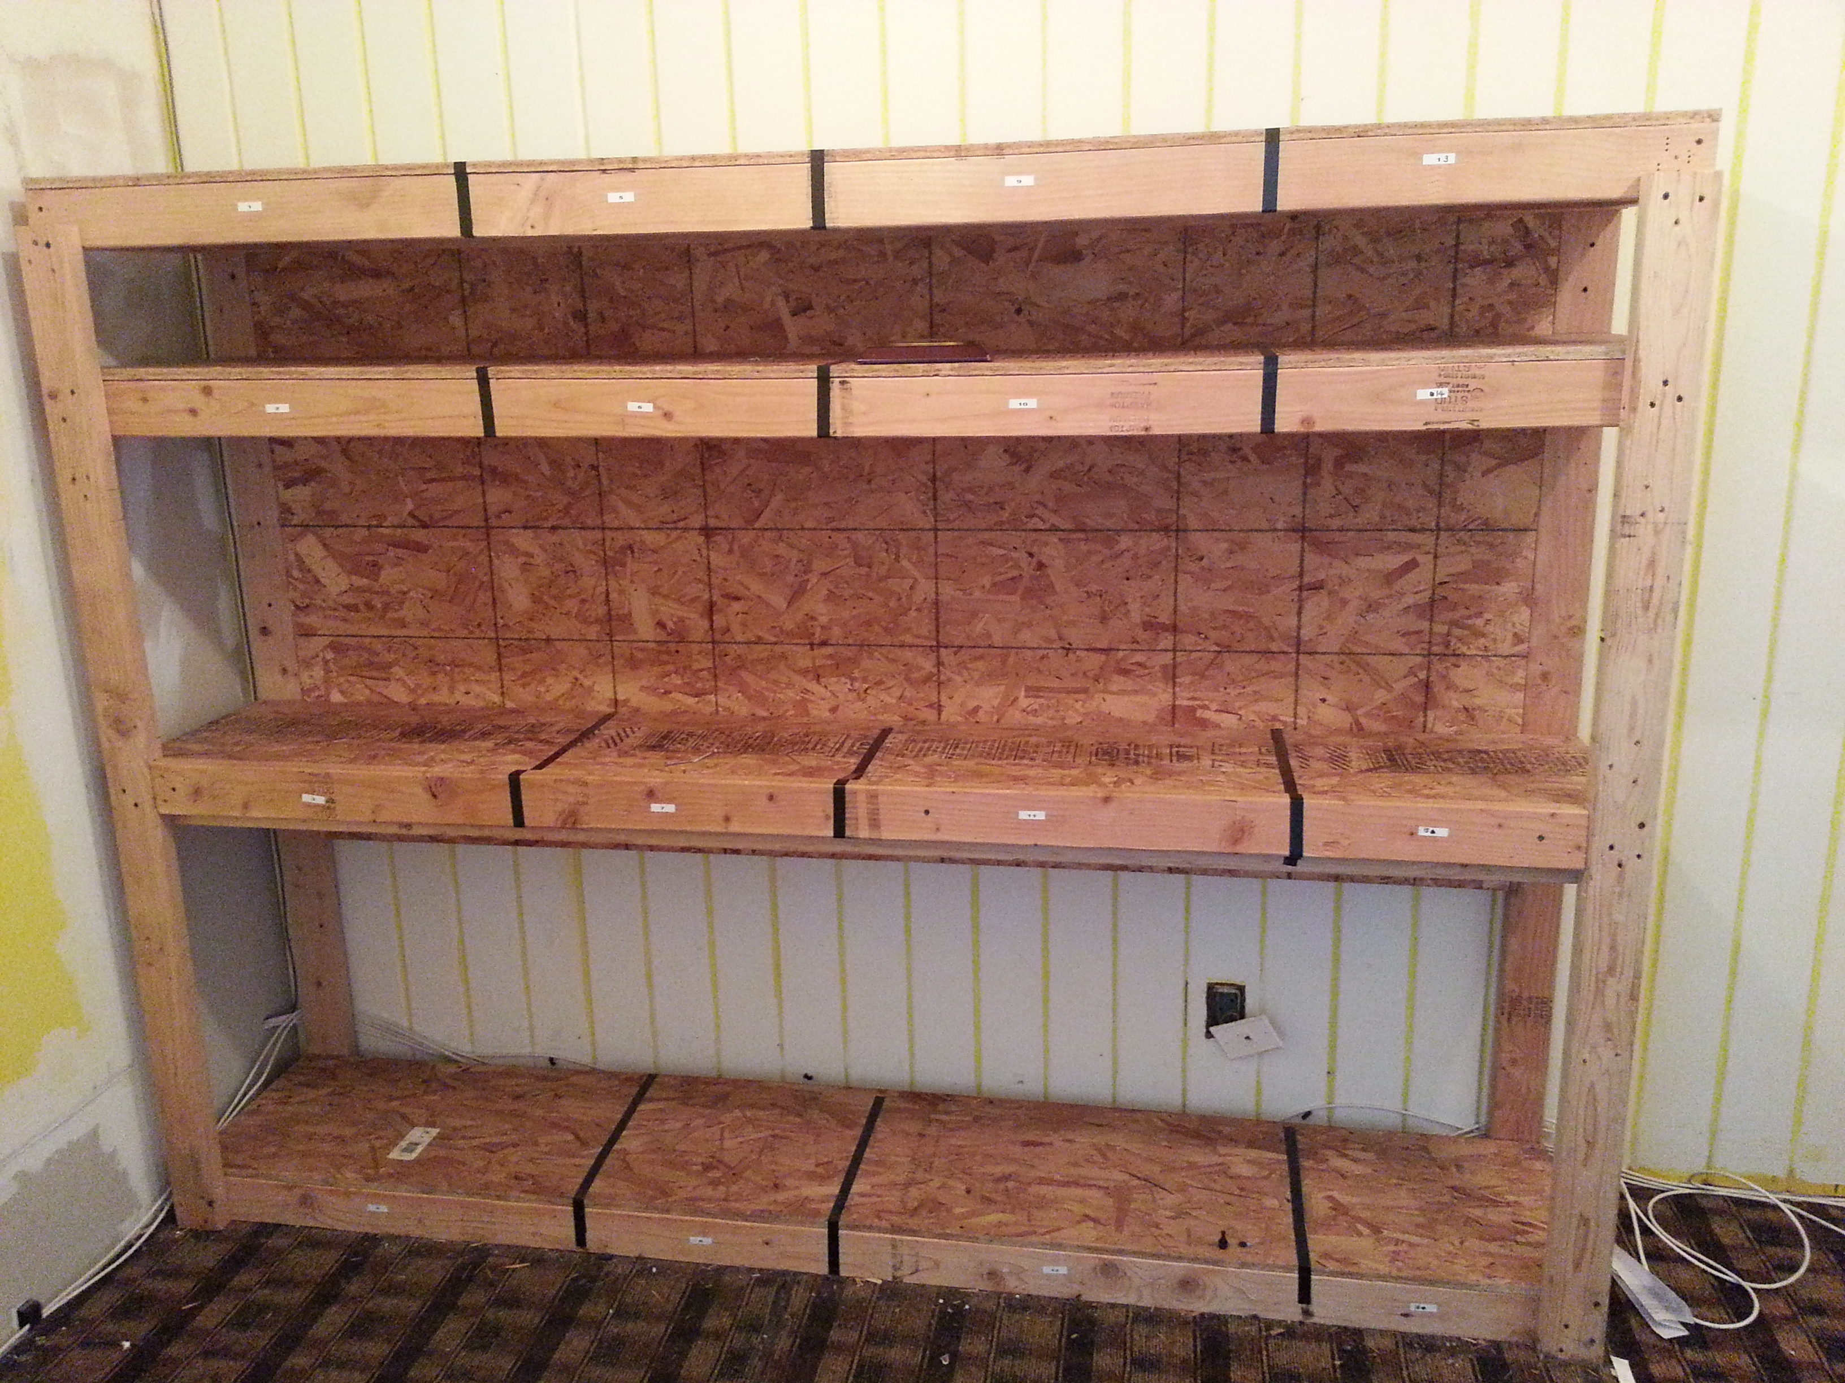

Slide 29
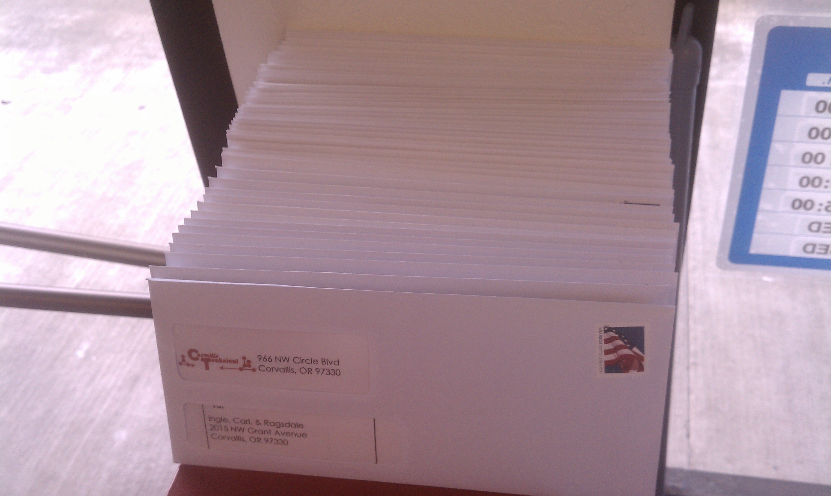

Slide 30
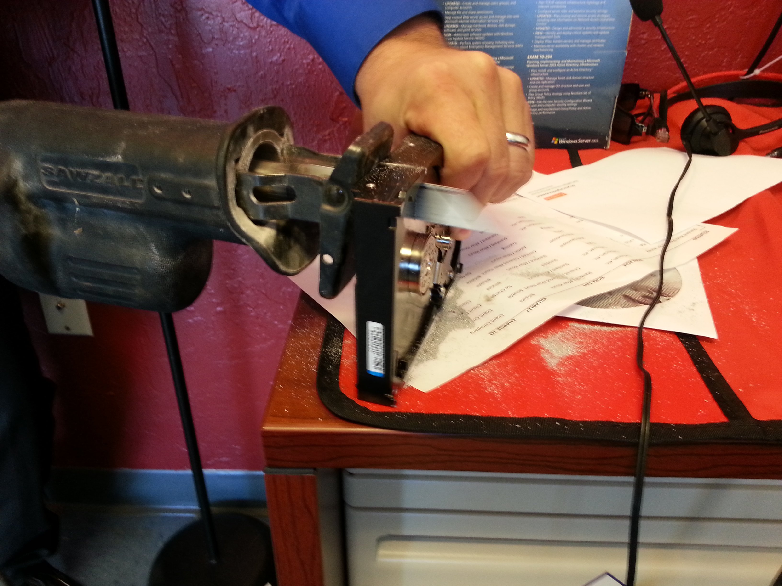
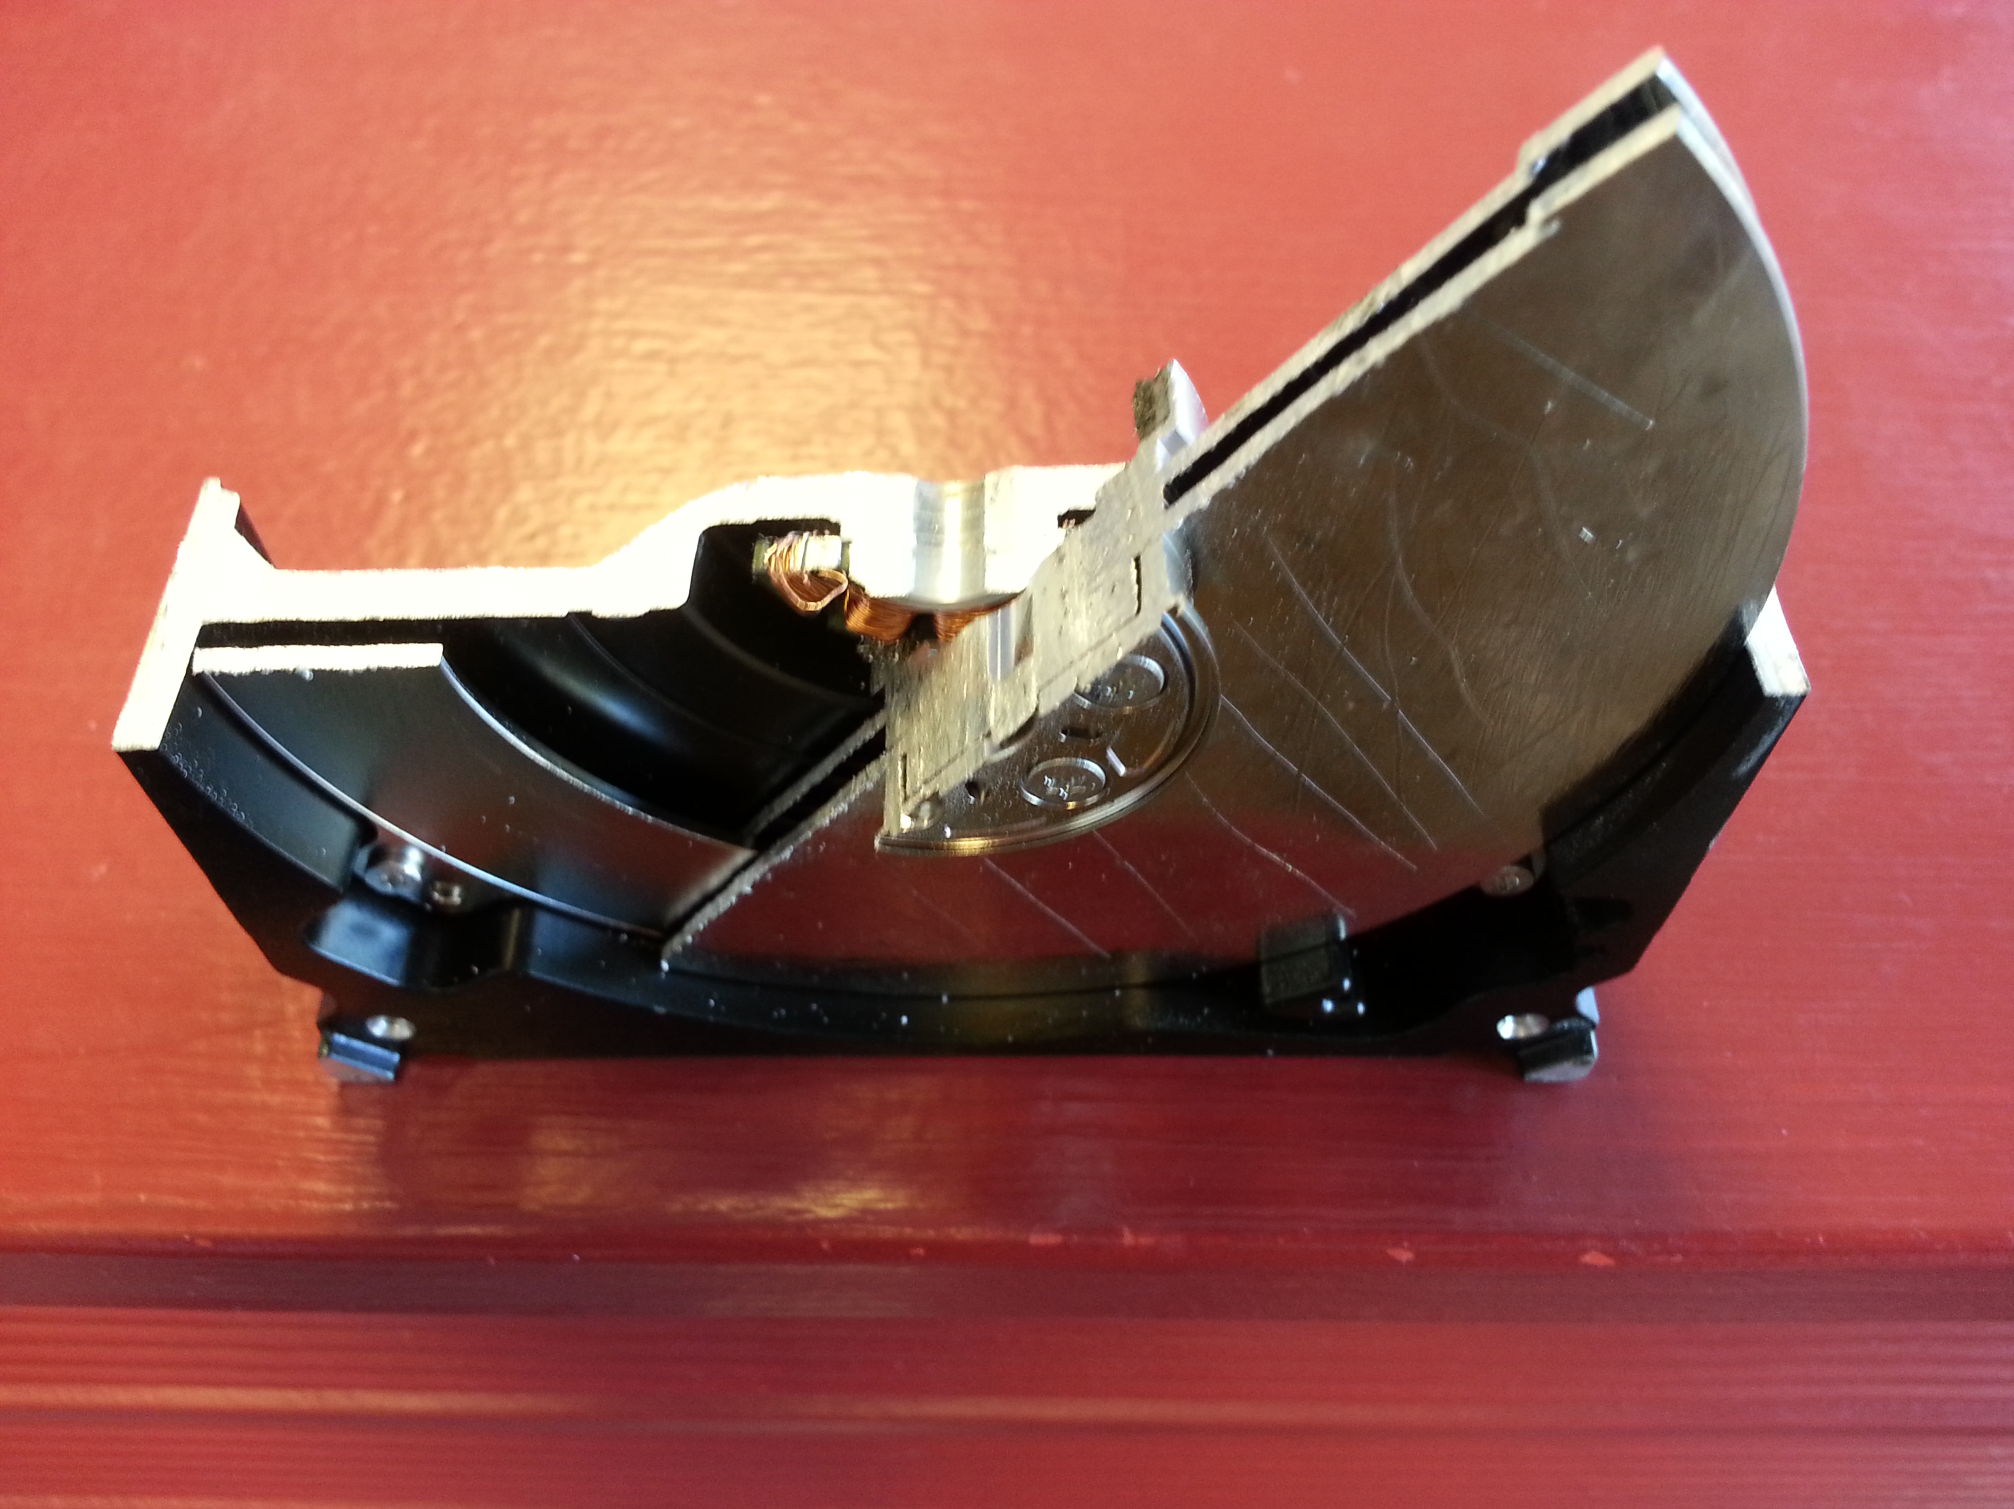
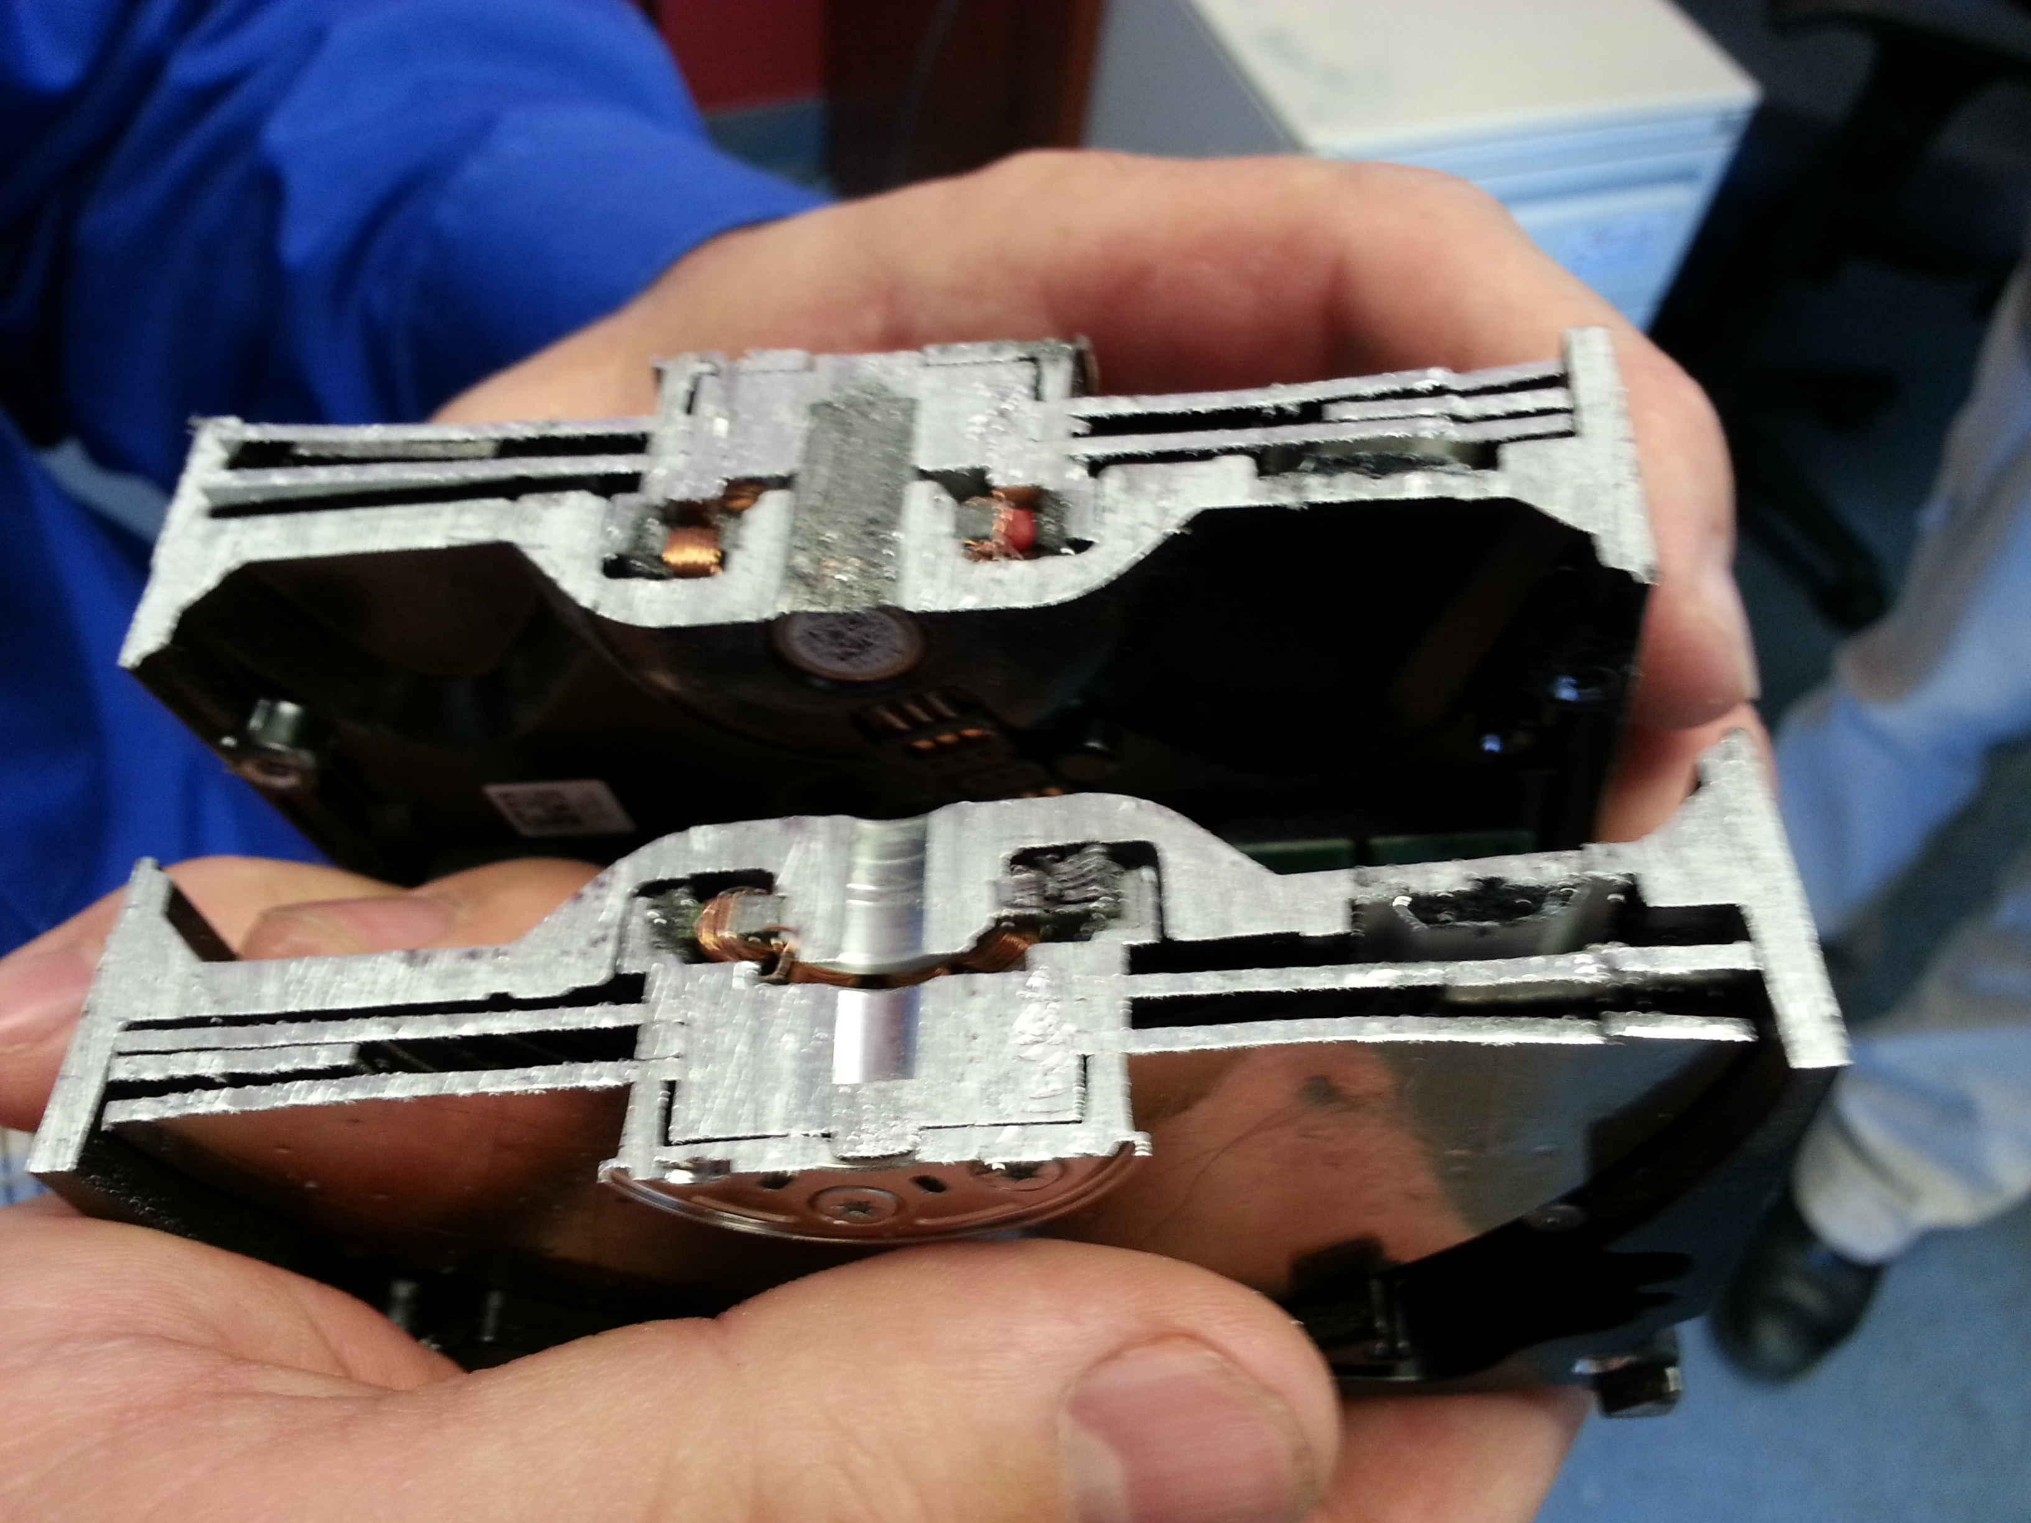
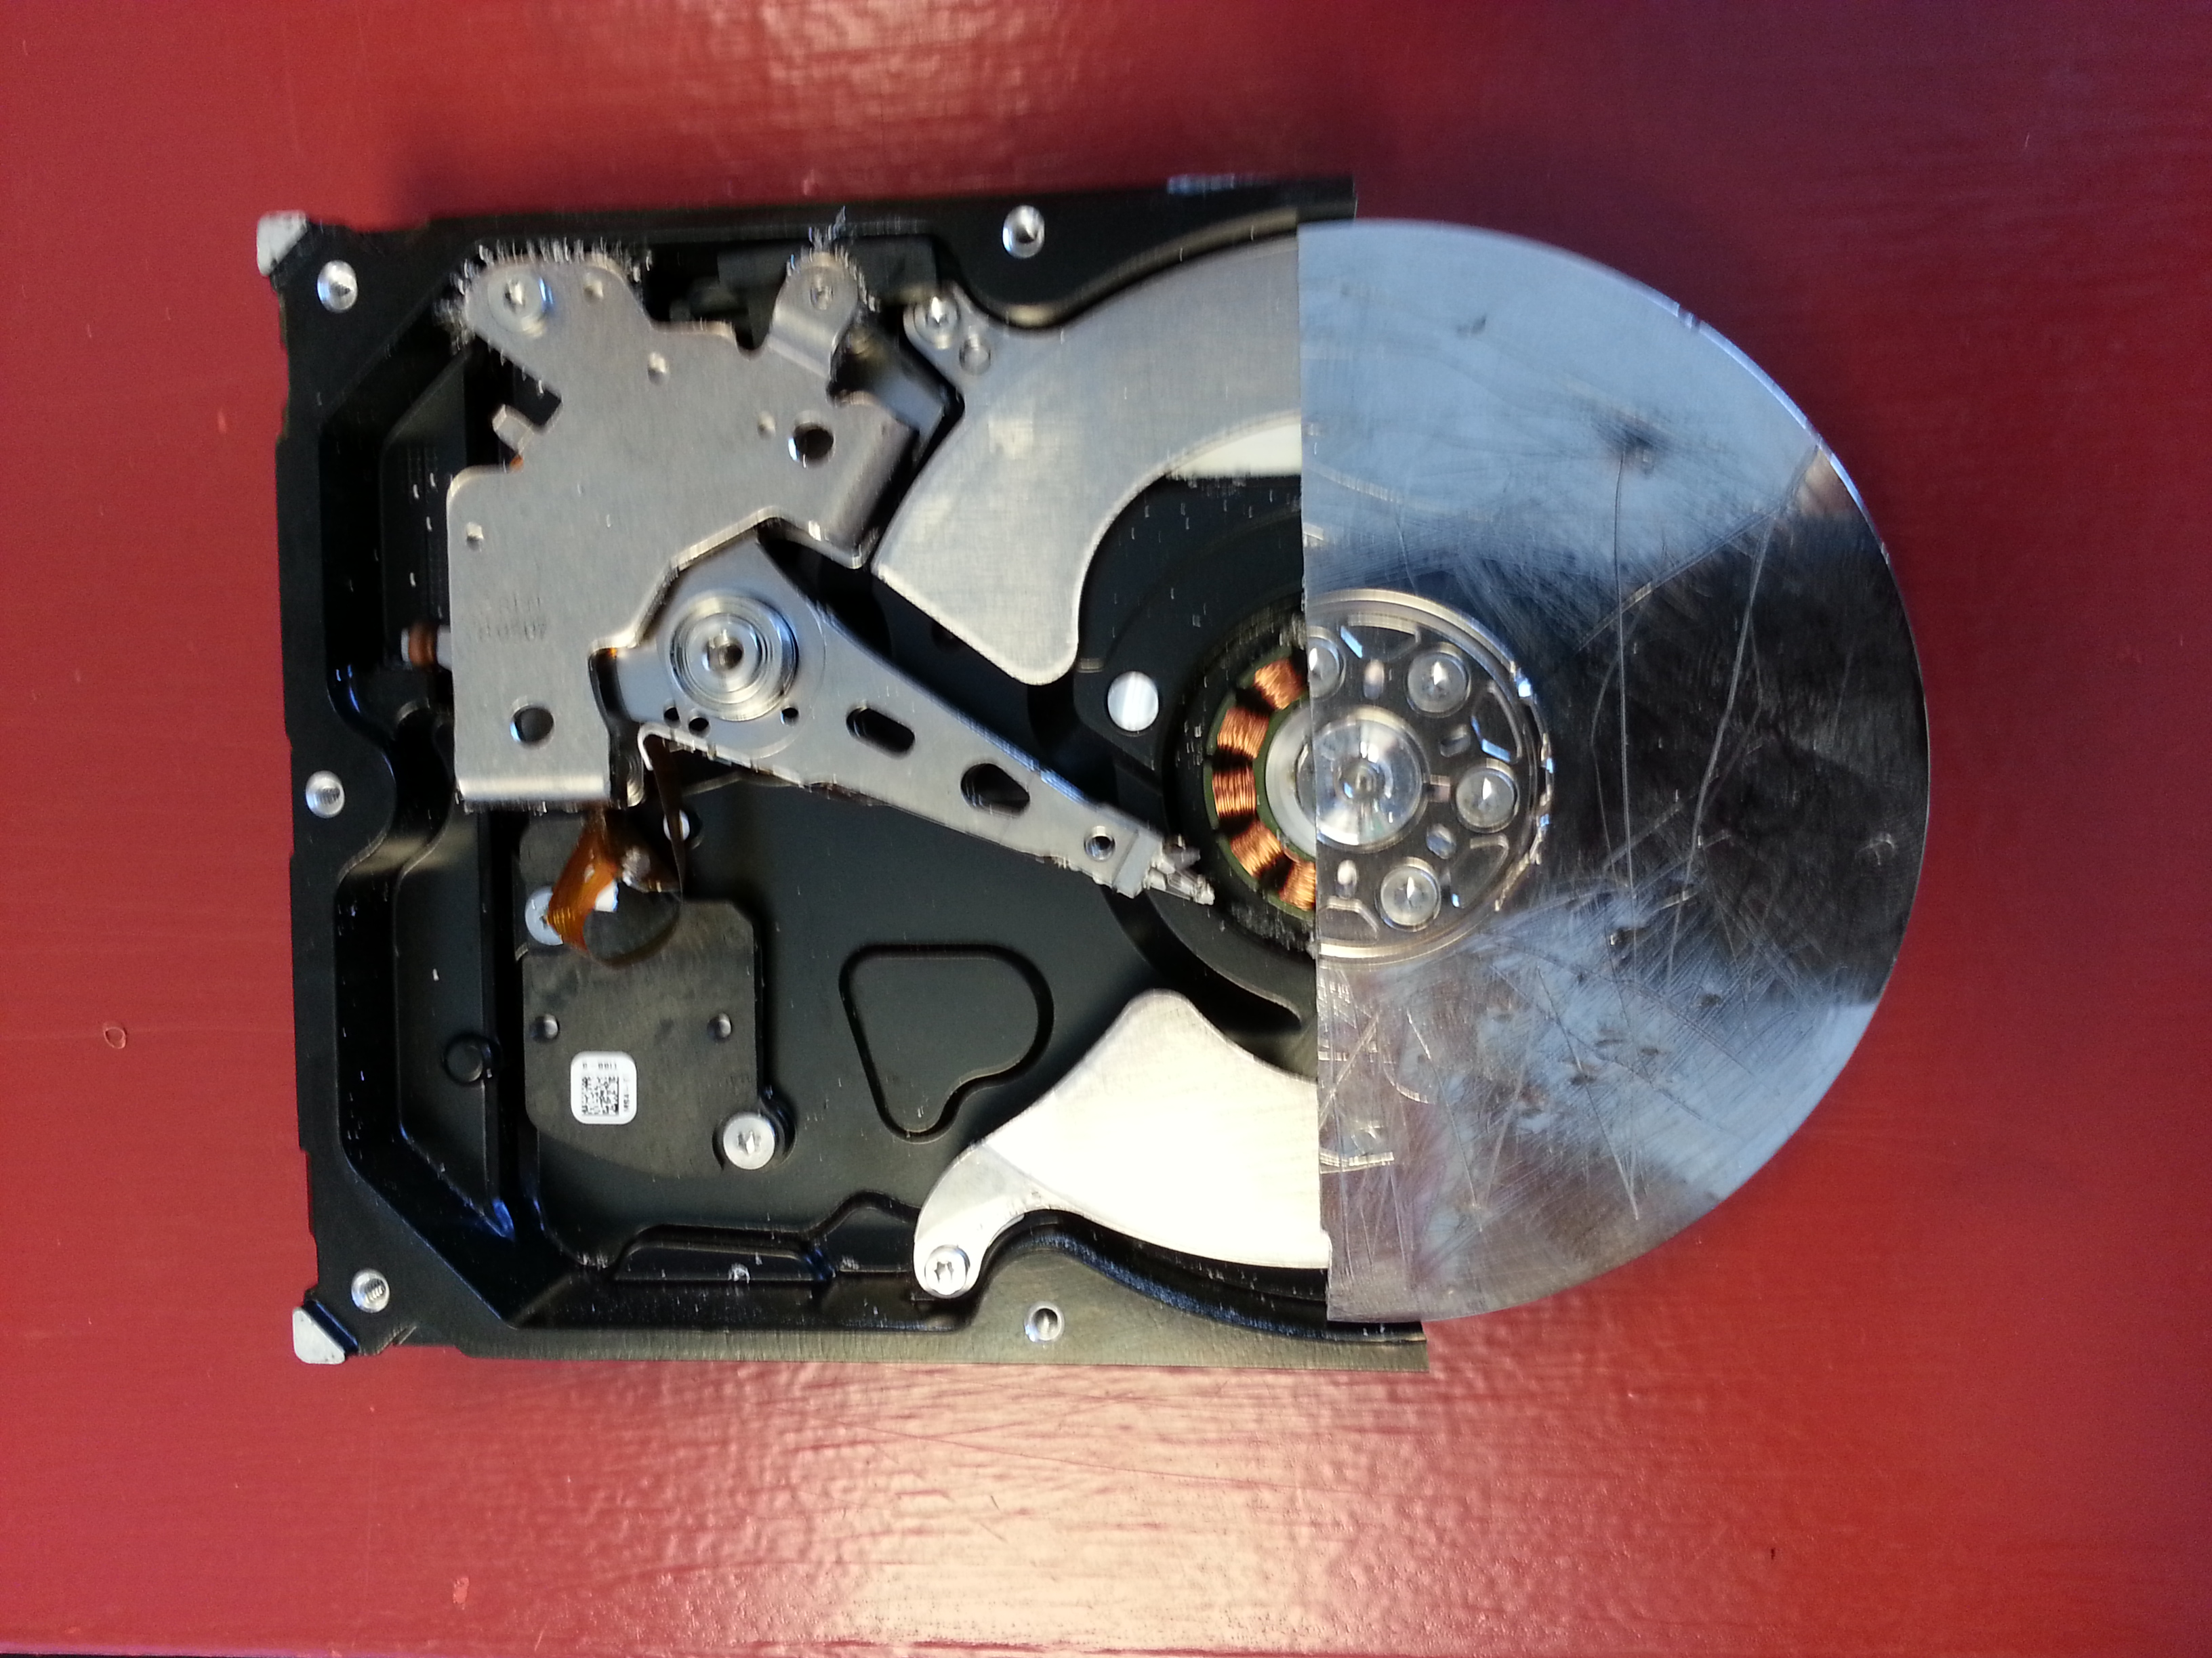

Slide 31
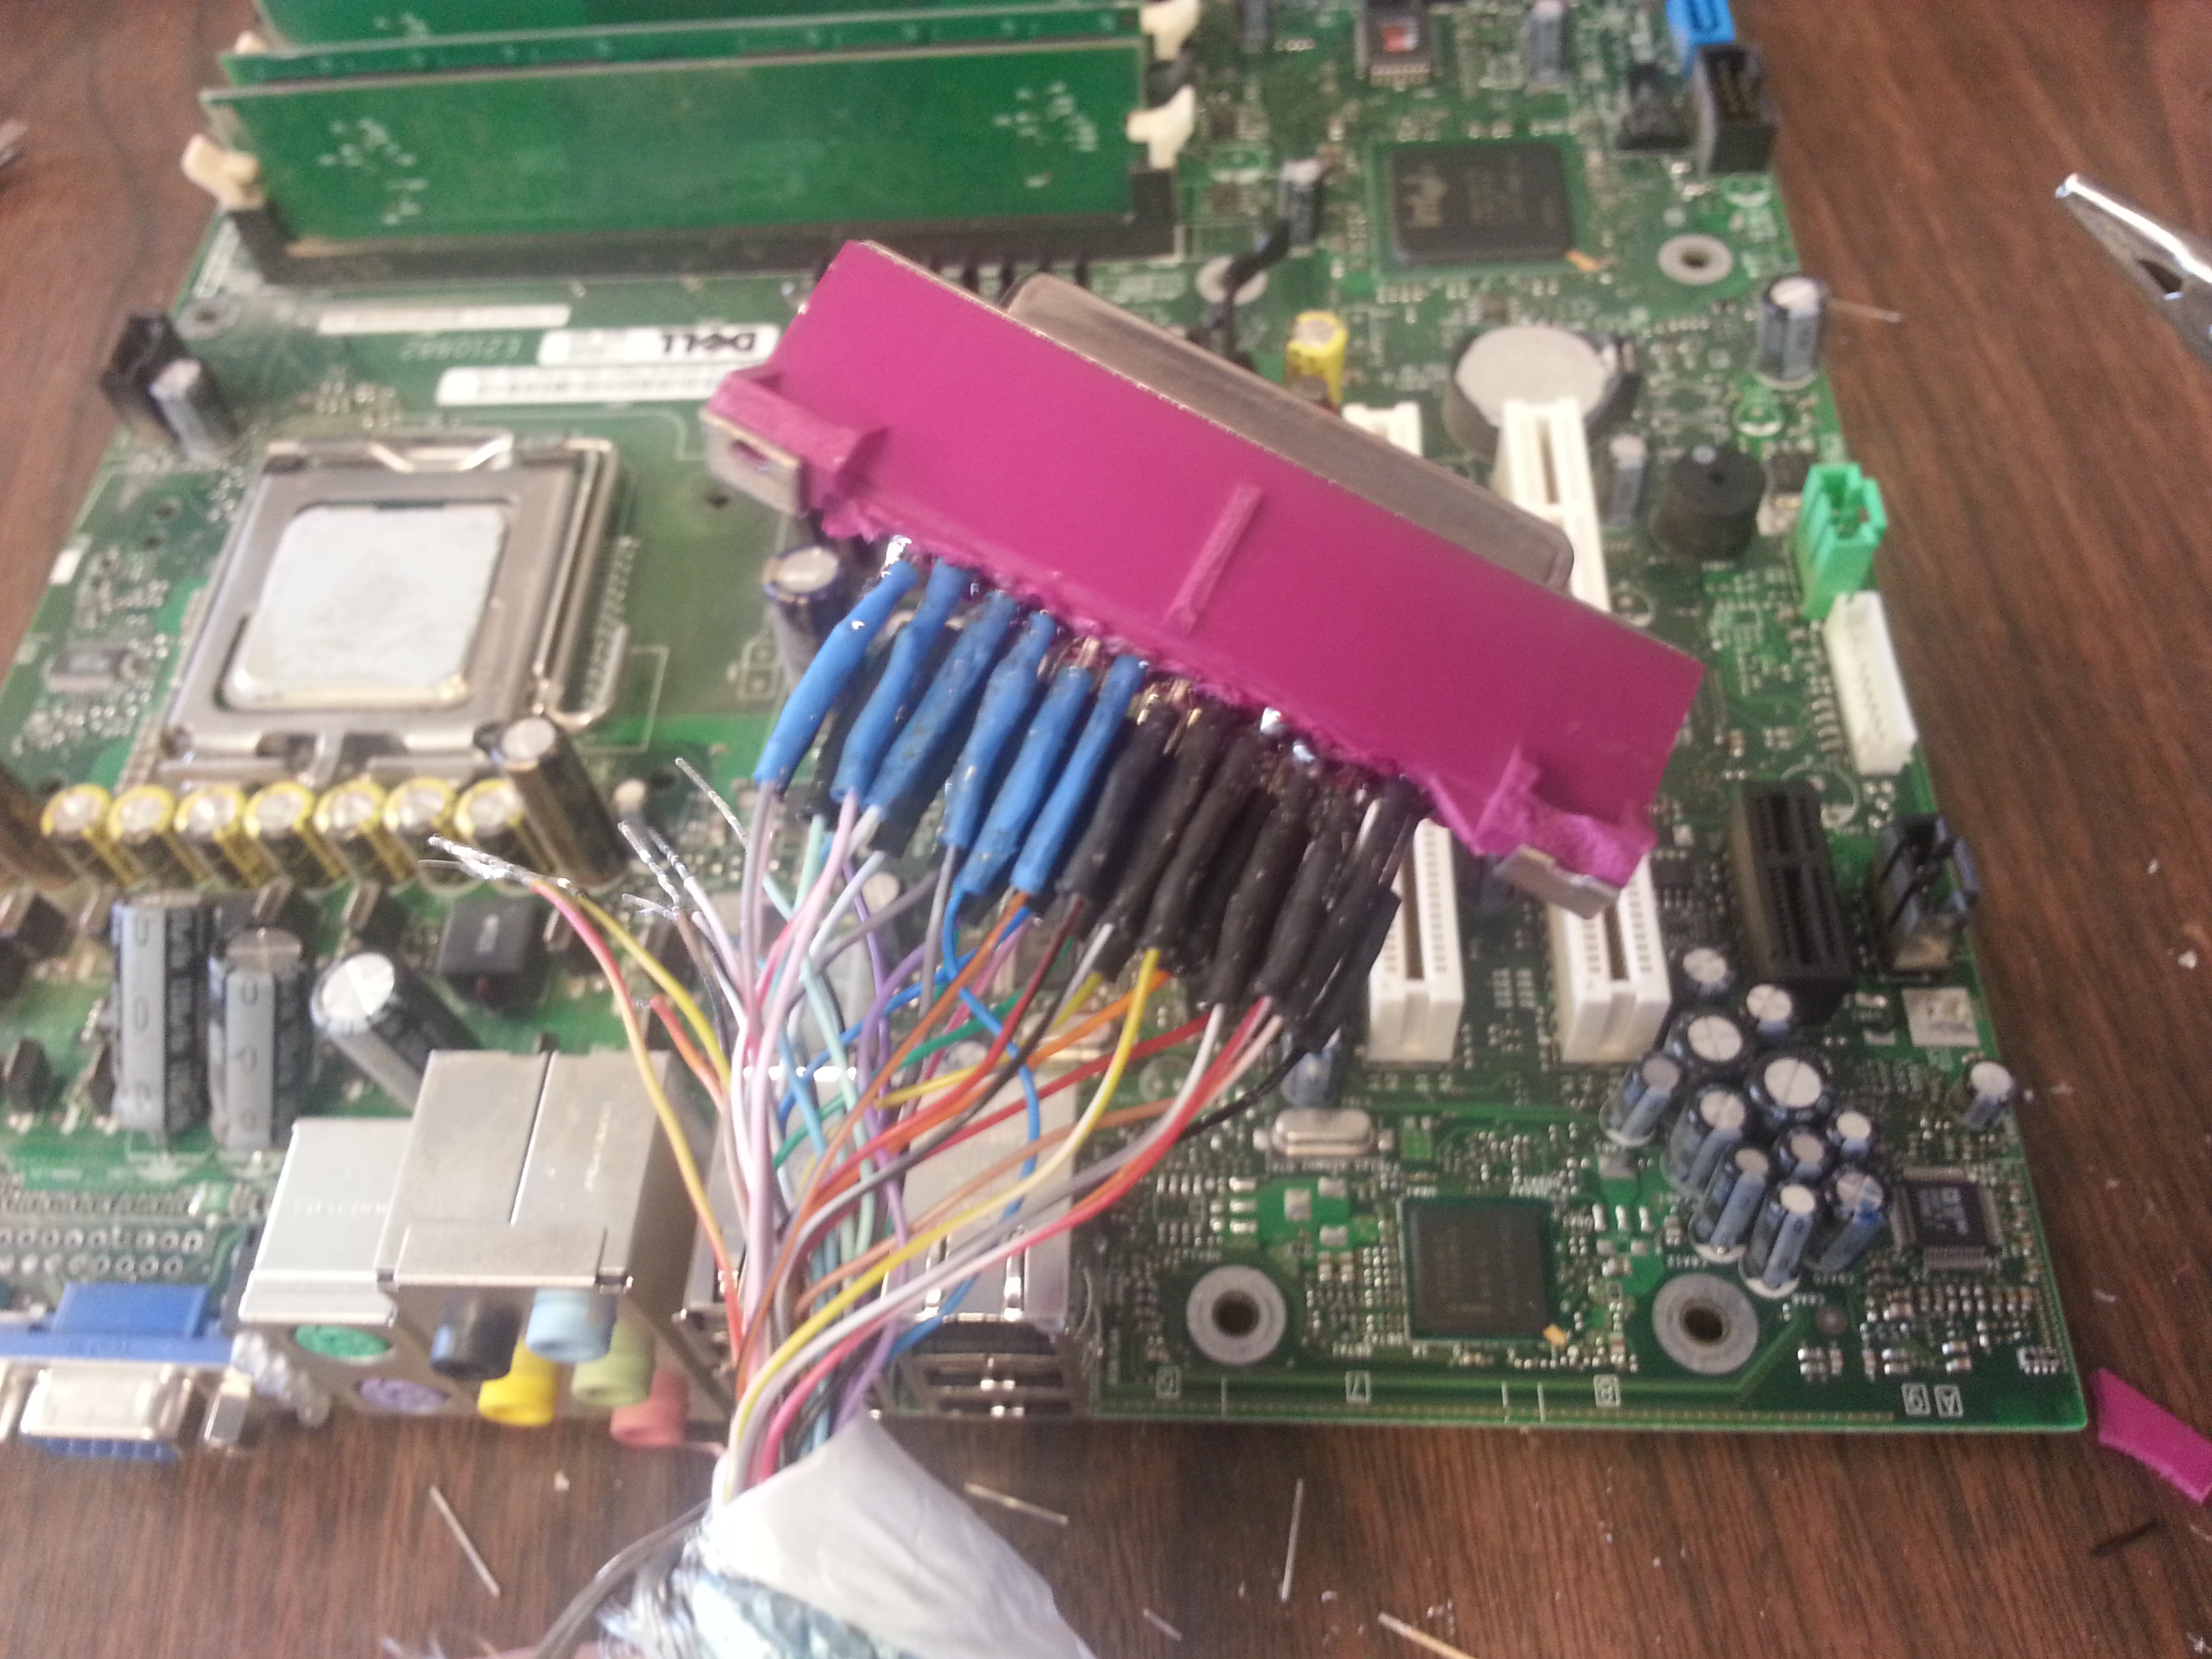
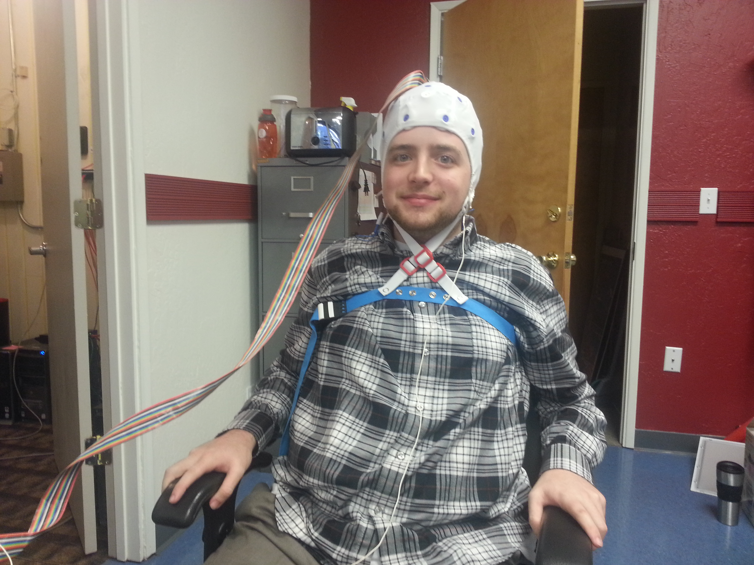

Slide 32
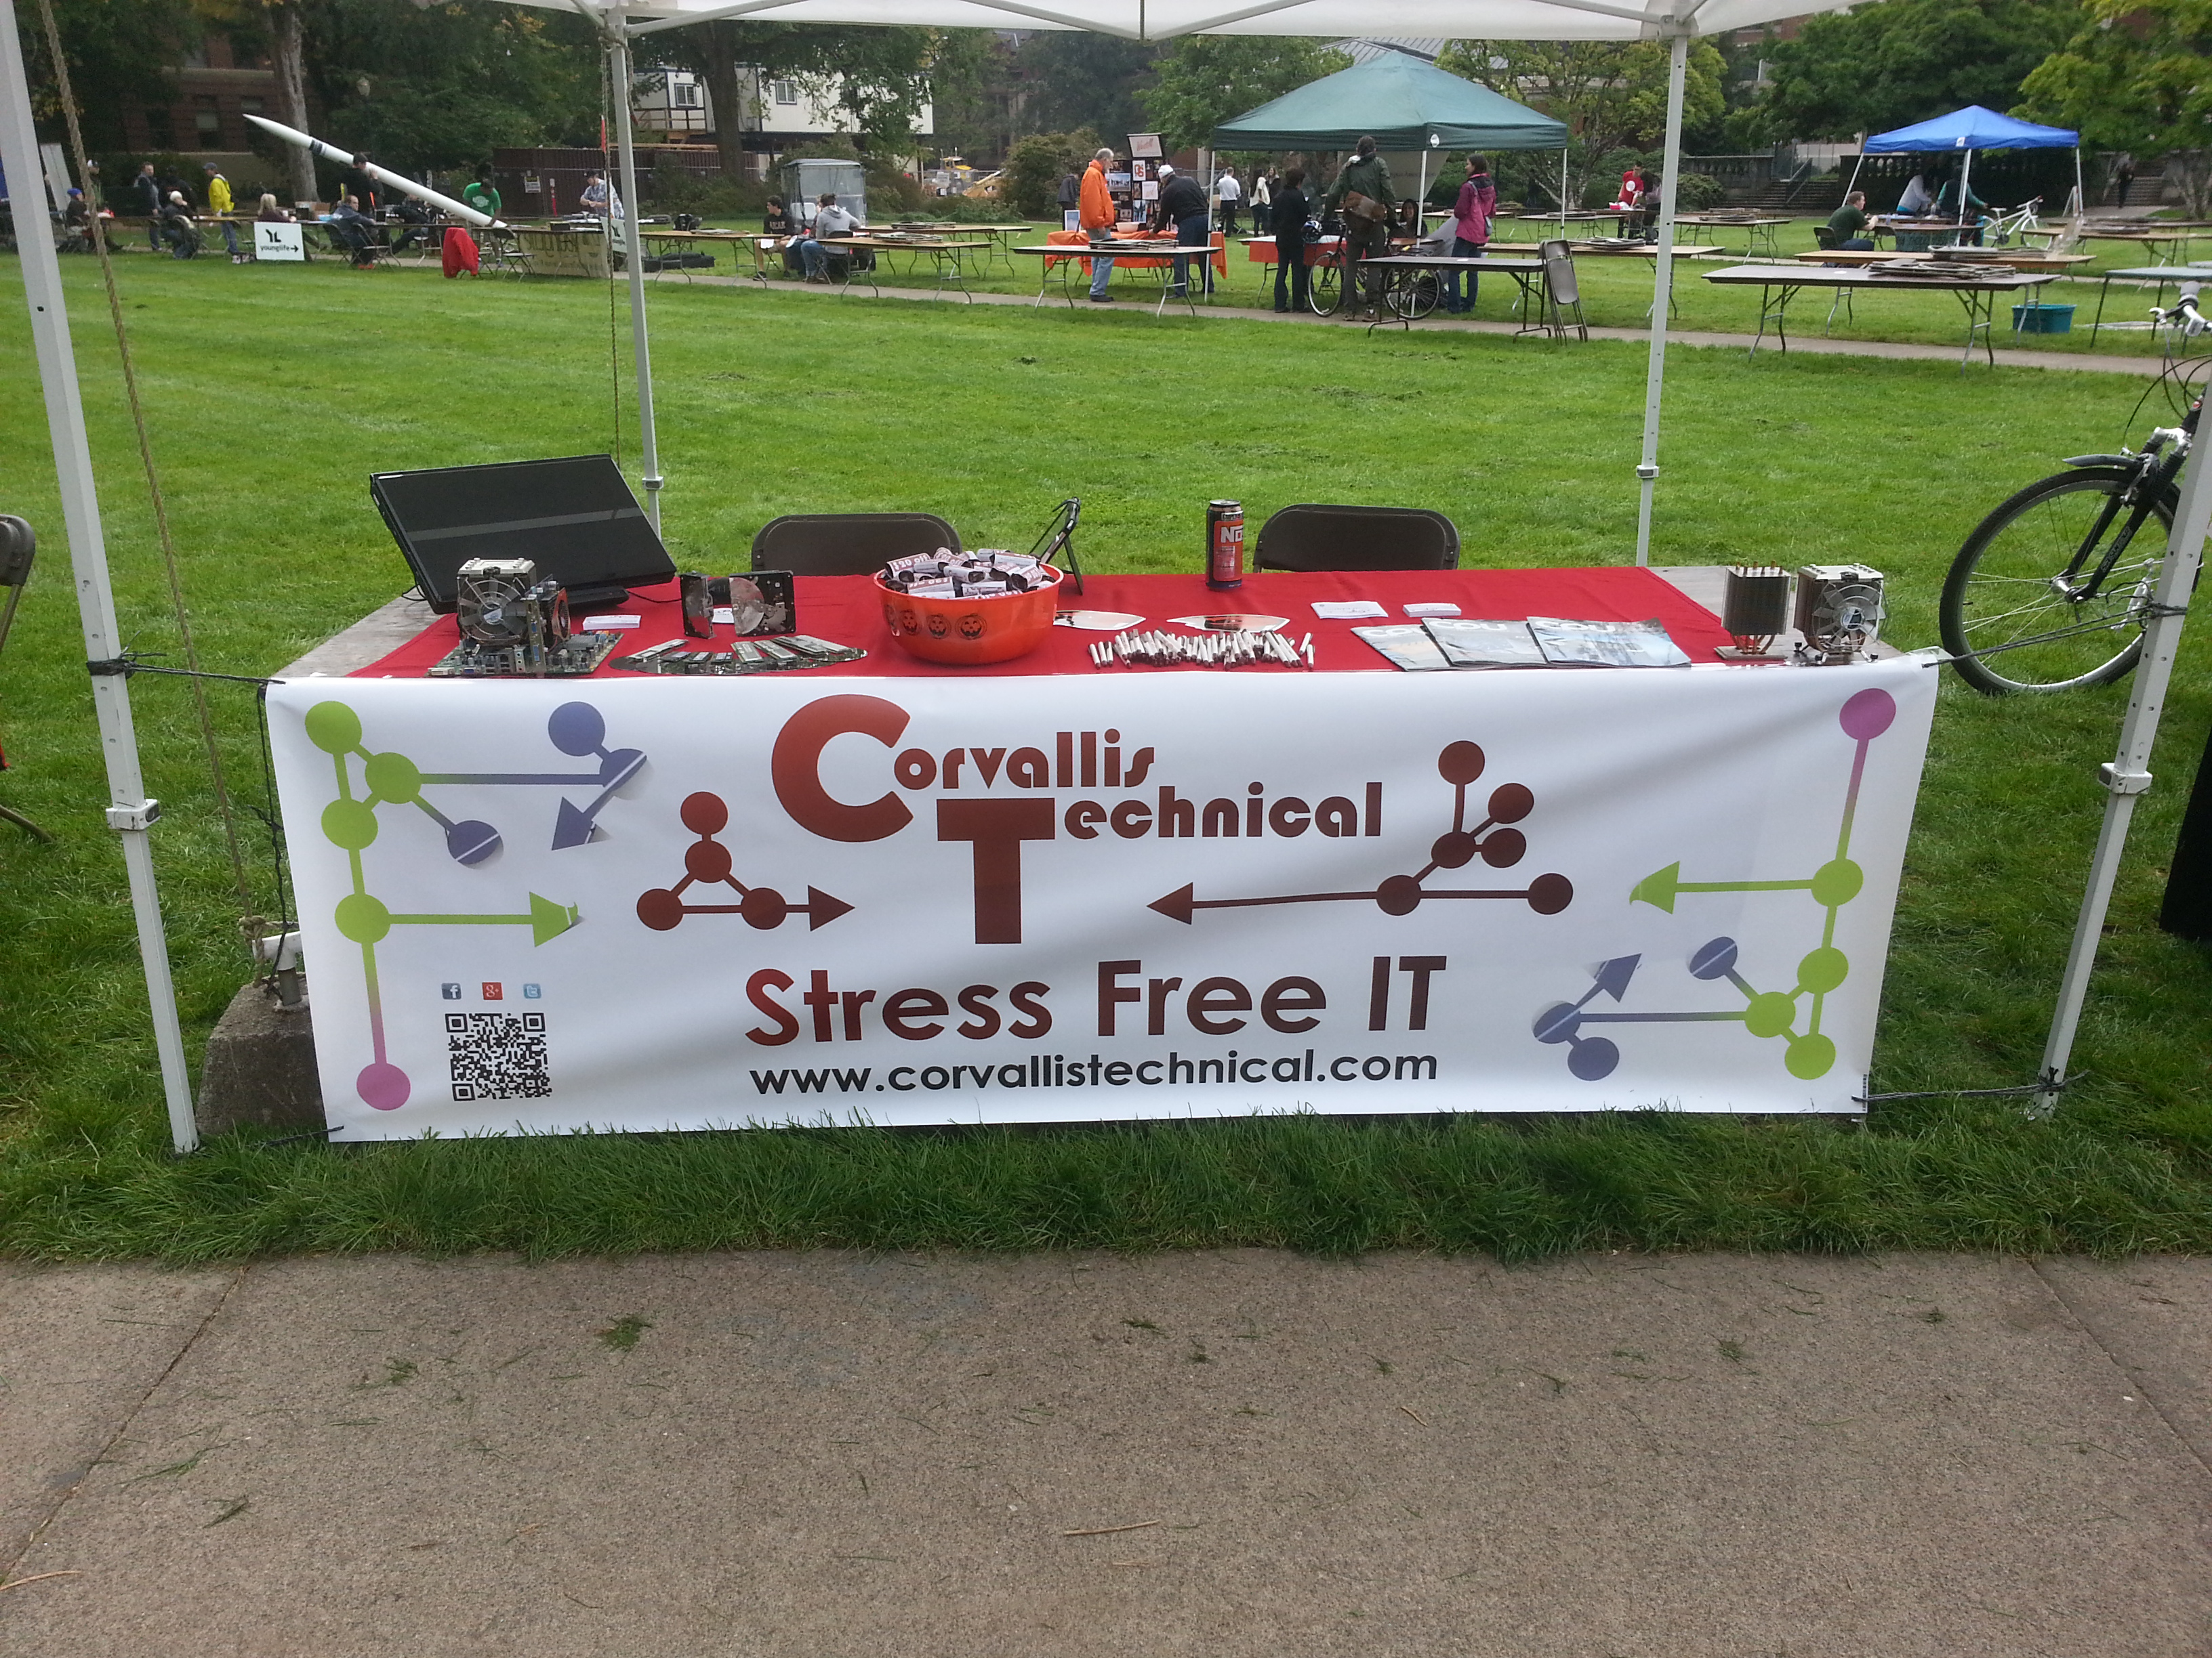

Slide 33
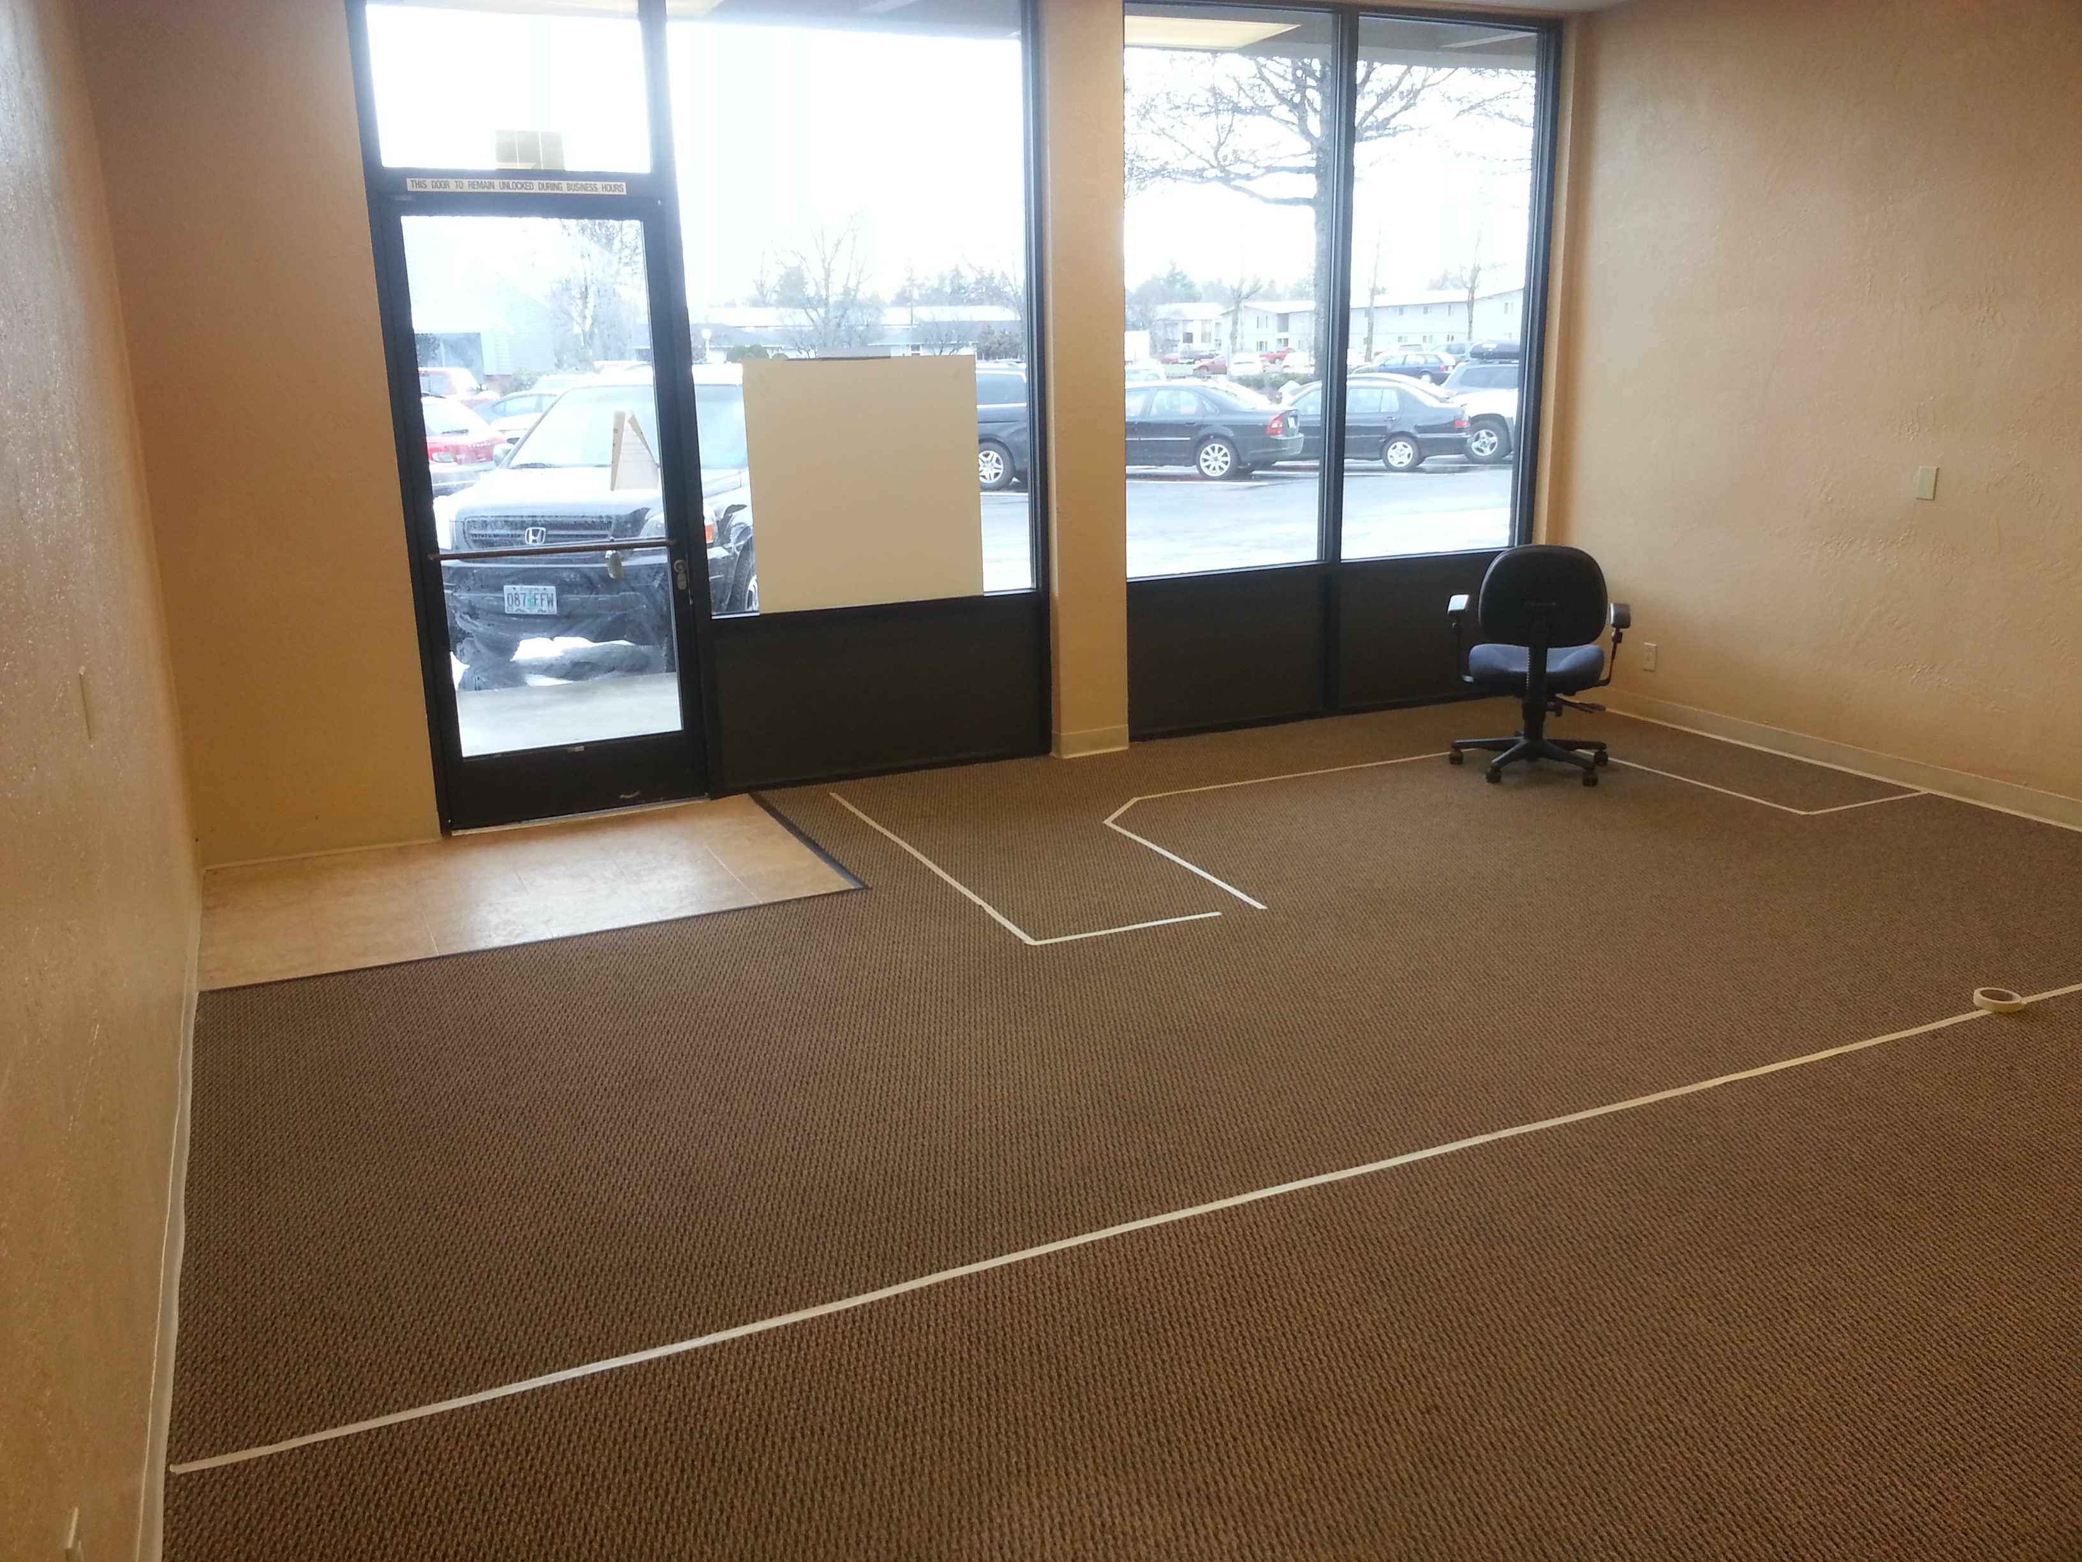

Slide 34
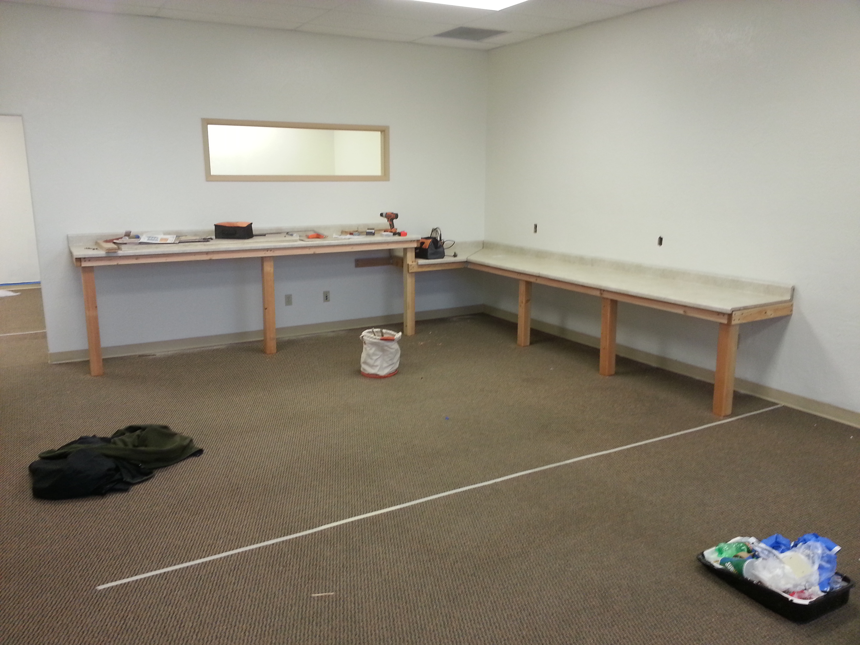

Slide 35
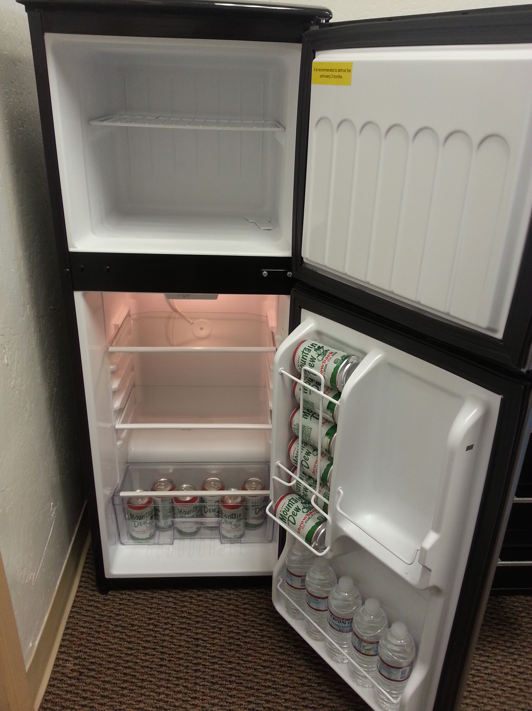

Slide 36
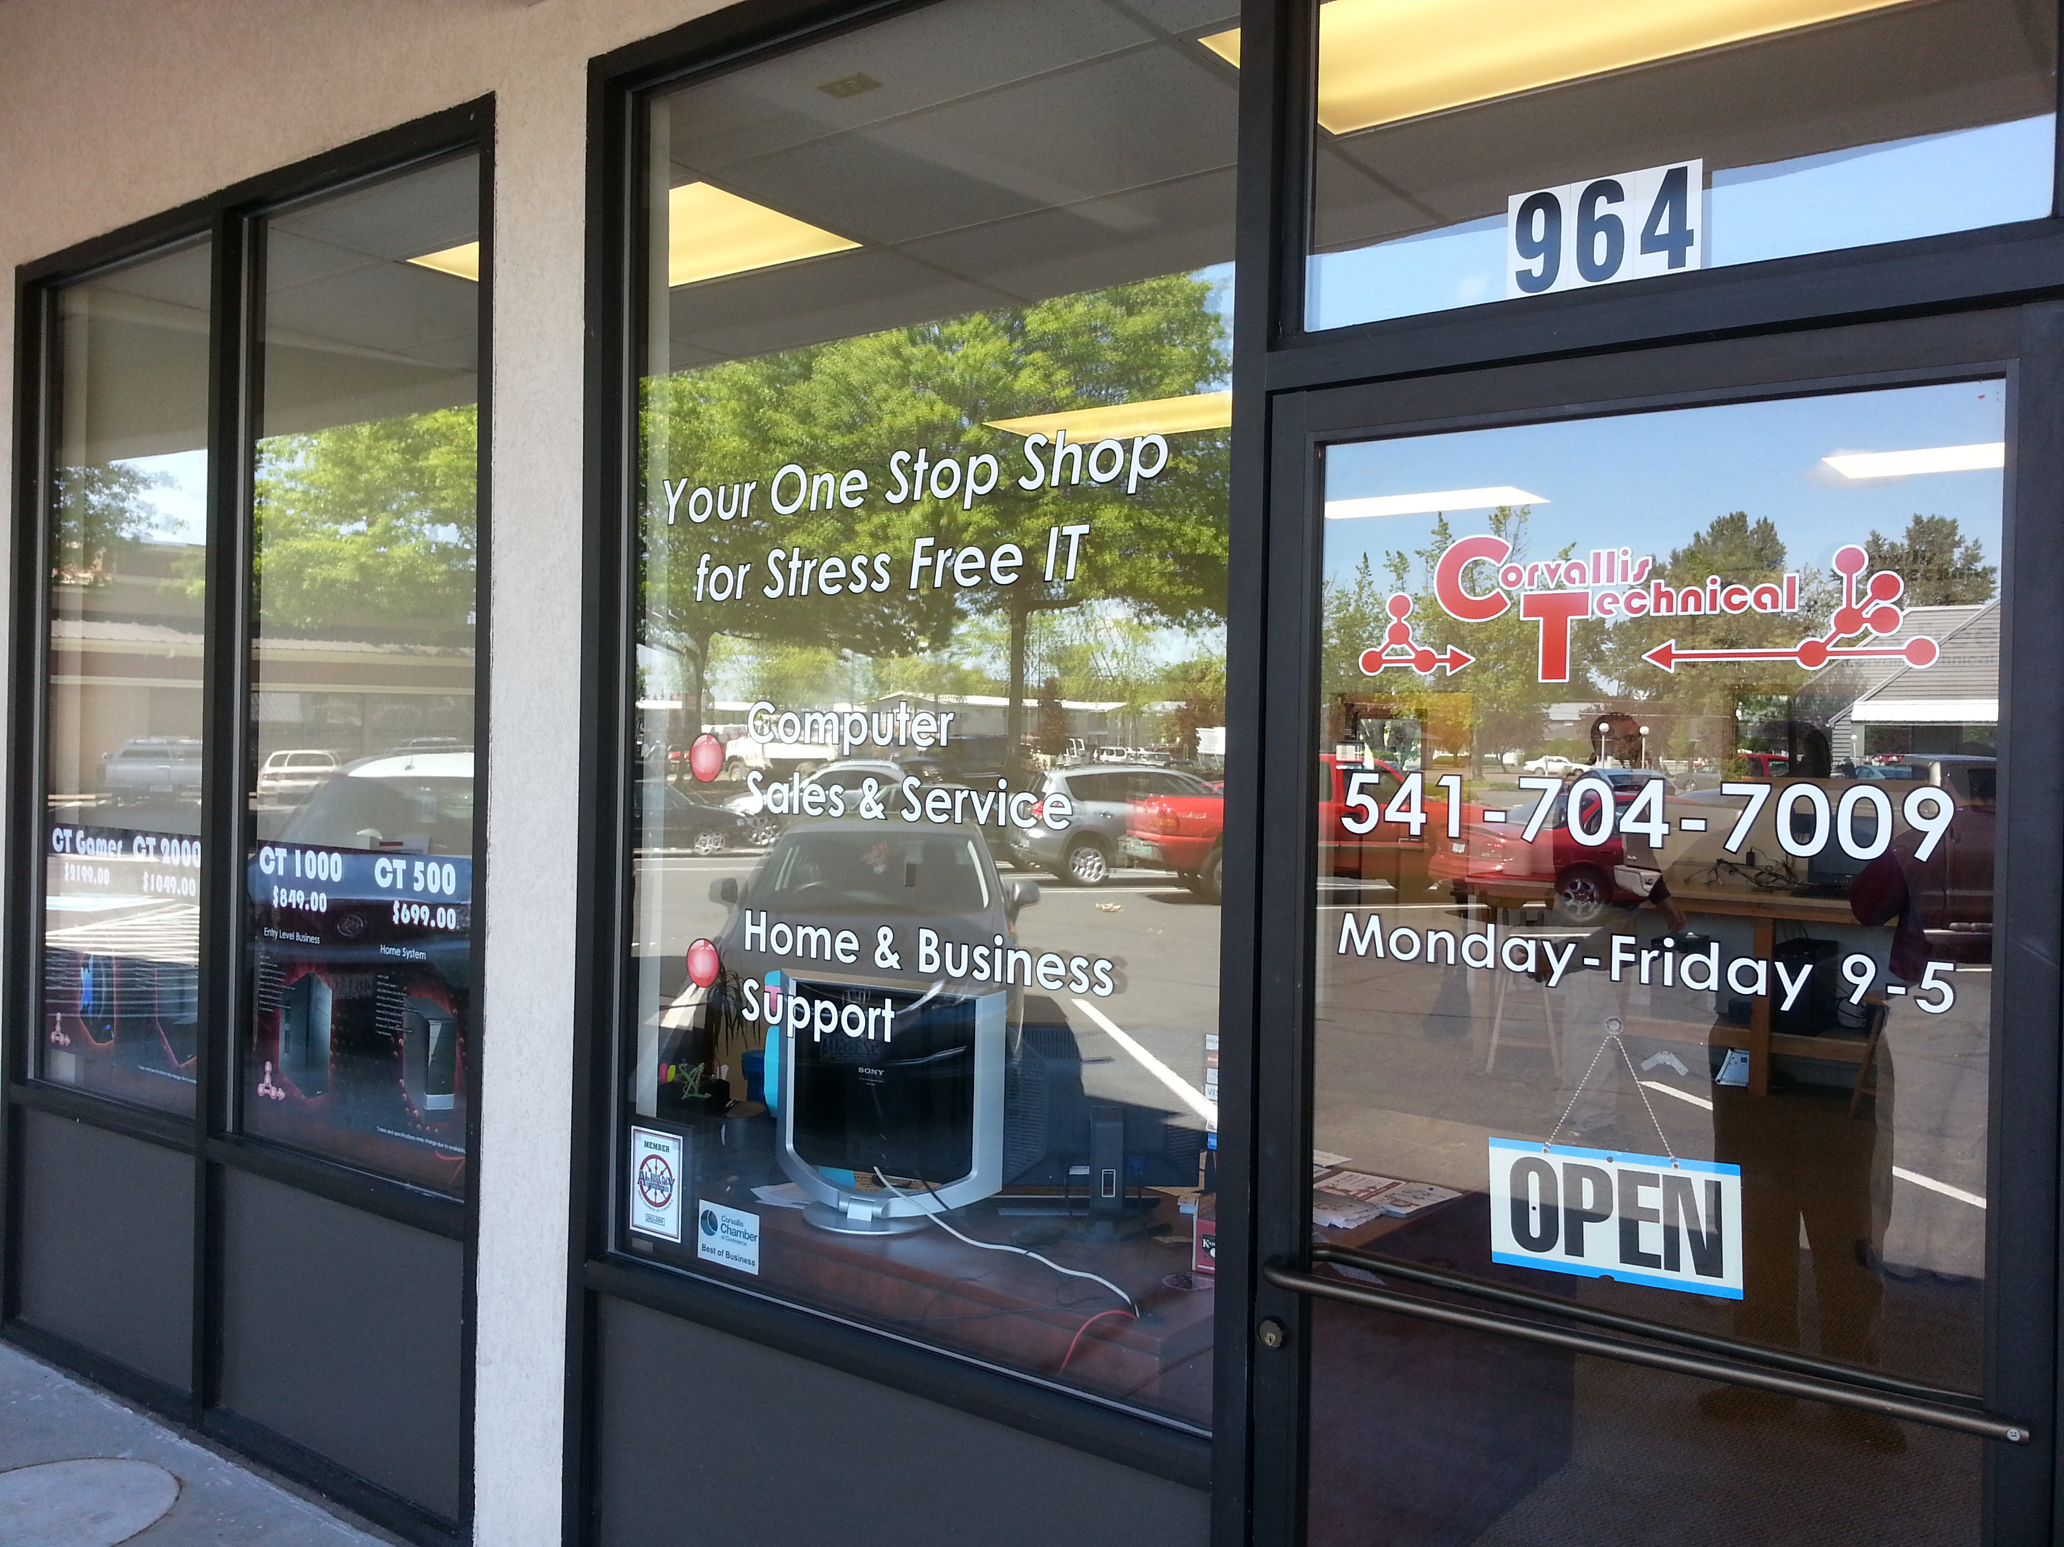

Slide 37
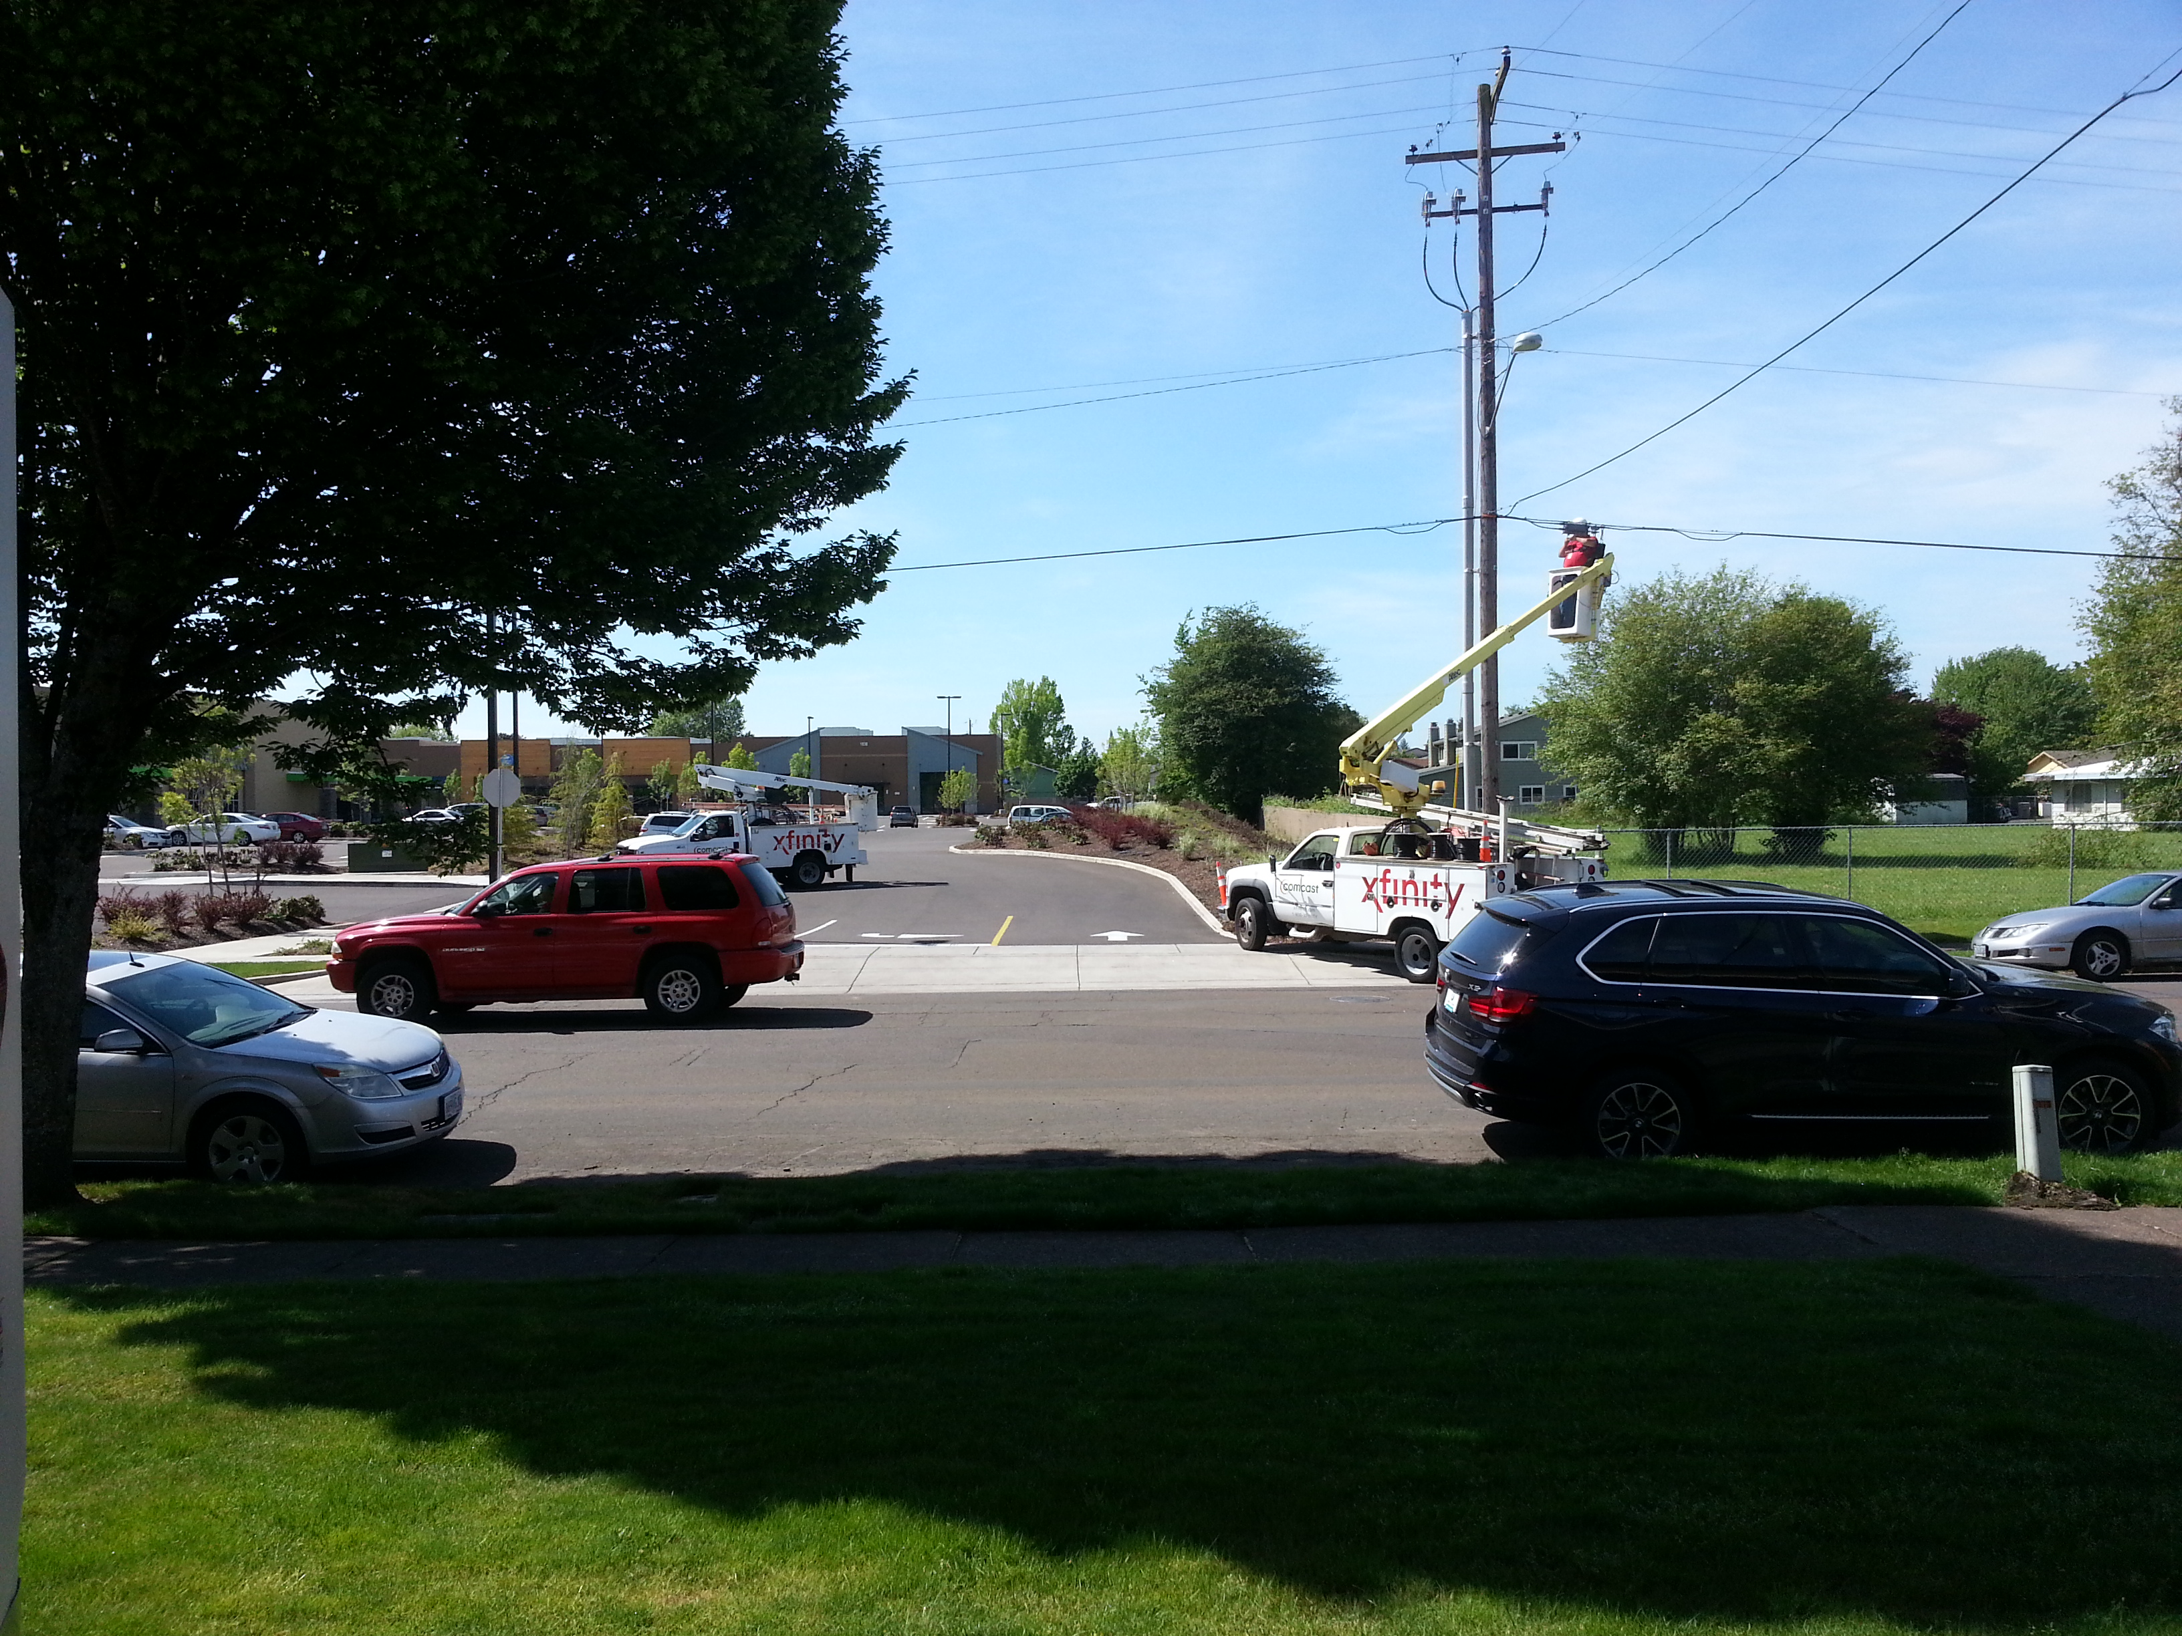
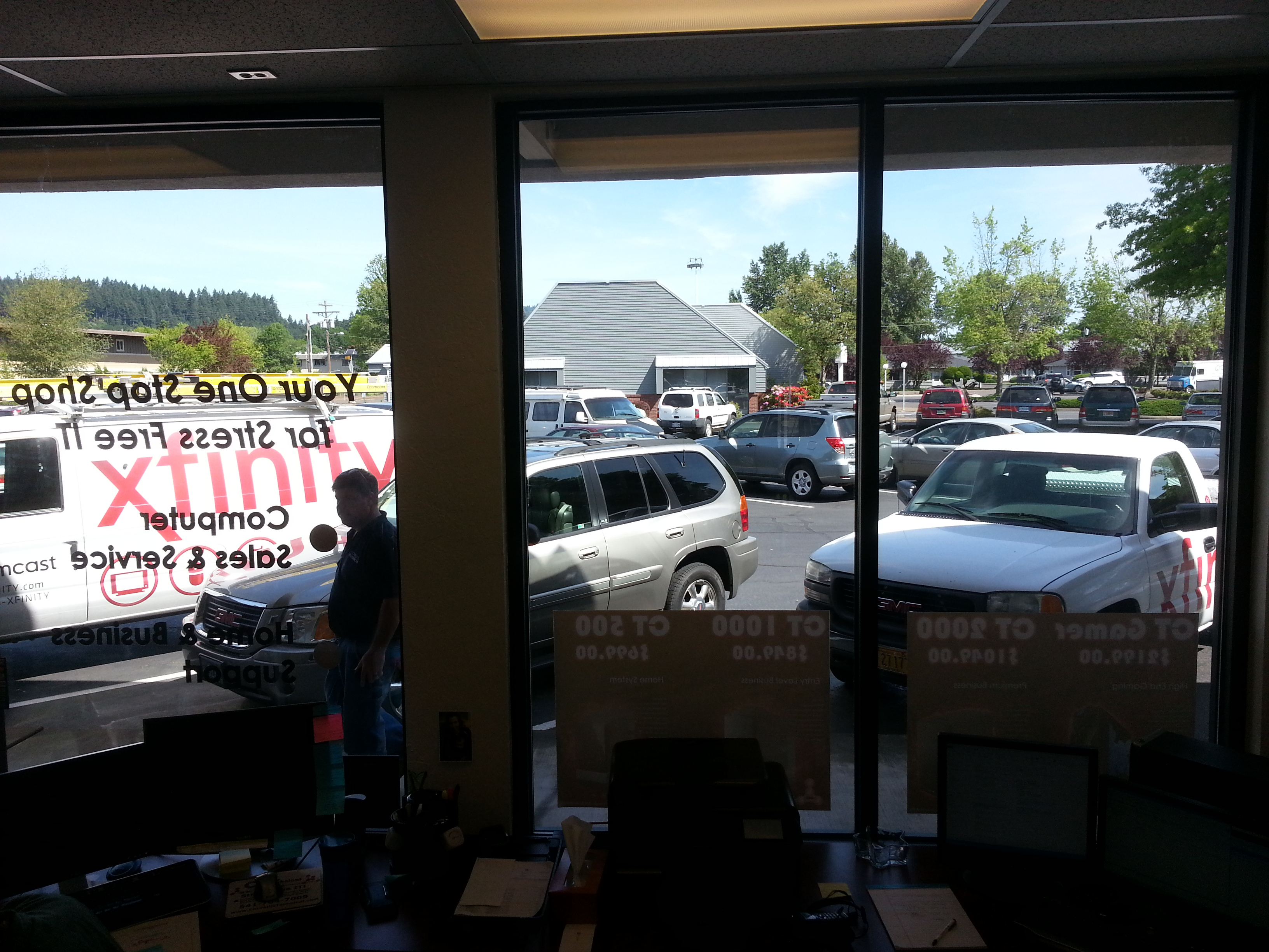

Slide 38
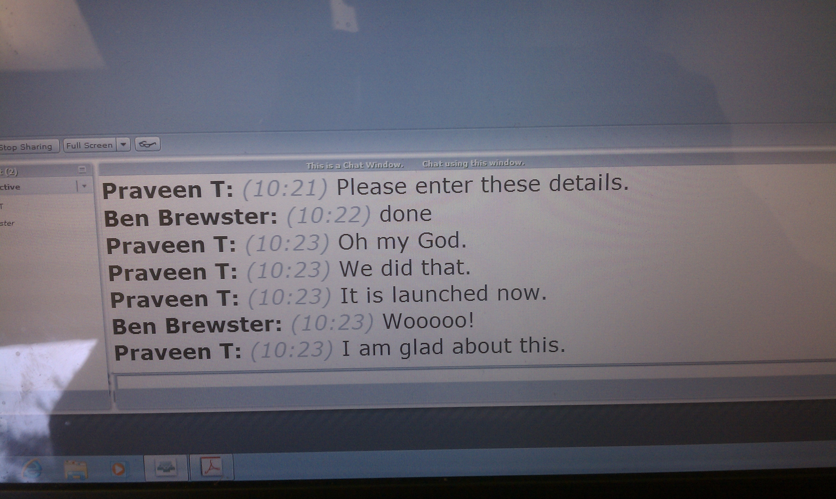

Slide 39
Conclusion
System administration is extremely lucrative
System administration will be a part of your entire life, because you are already good at it
Remember that there is hardware, somewhere, running the software you write and use
Document everything you do: you will improve your process, prove things when needed, complete projects accurately, and bill correctly
Thank you so much for trusting me with this class!

